Slide 1

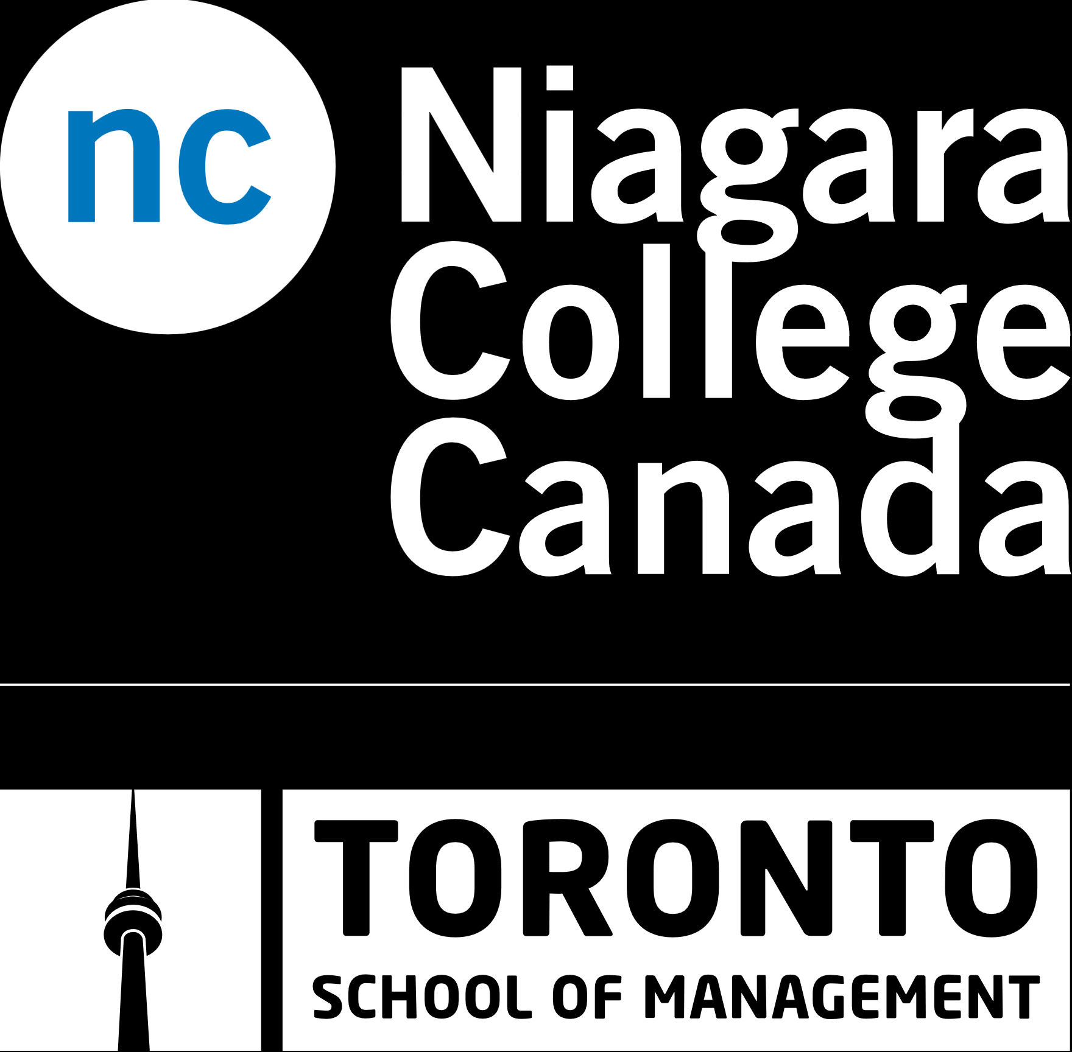
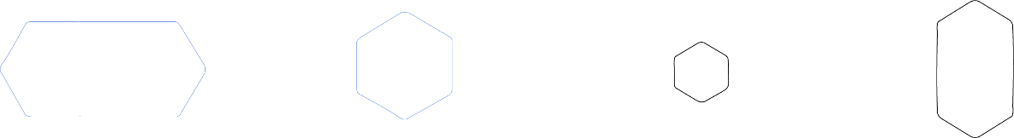
Course title :Mobile and Windows Store Development
Code :PROG1442
Instructor's name :
Session Number : 5
Date : 2024
Spring 2024
niagaracollegetoronto.ca

Slide 2

Week | Topic | Assessments and Activities | Learning Objectives
Week 4 | XAML and UI Design Continued • Building on the XAML introduction, this week delves deeper into XAML concepts. • Attribute Element syntax and Property Element syntax for more advanced UI design. | Lecture and Discussions Test 2: 10 %. | Objective 2: Design and create UI using Extensible Application Markup Language (XAML). 2.3: Explore the Visual Tree for controlling XAML objects. 2.4: Demonstrate data binding using the {Binding} markup extension. 2.5: Explain the creation of XAML App Resources.
RECAPE

Slide 3
Week | Topic | Assessments and Activities | Learning Objectives
Week 5 | Implementing the MVVM Design Pattern • This week introduces the Model-View-View Model (MVVM) design pattern, a • The MVVM architecture and its benefits regarding separation of concerns and maintainability. | Lecture and Discussions Project 1 issued with an explanation. | Objective 3: Implement the Model-View-View Model (MVVM) design pattern for data-connected applications. crucial concept for building data-connected applications. 3.1: Describe occasionally connected programming and database access. 3.2: Introduce MVVM application frameworks for attribute-based page and view model discovery.
AGENDA

Slide 4

Objective 3: Implement the Model-View-View Model (MVVM) design pattern for data-connected applications

Slide 5
PART 1
Database setup to connect Mobile Application

Slide 6
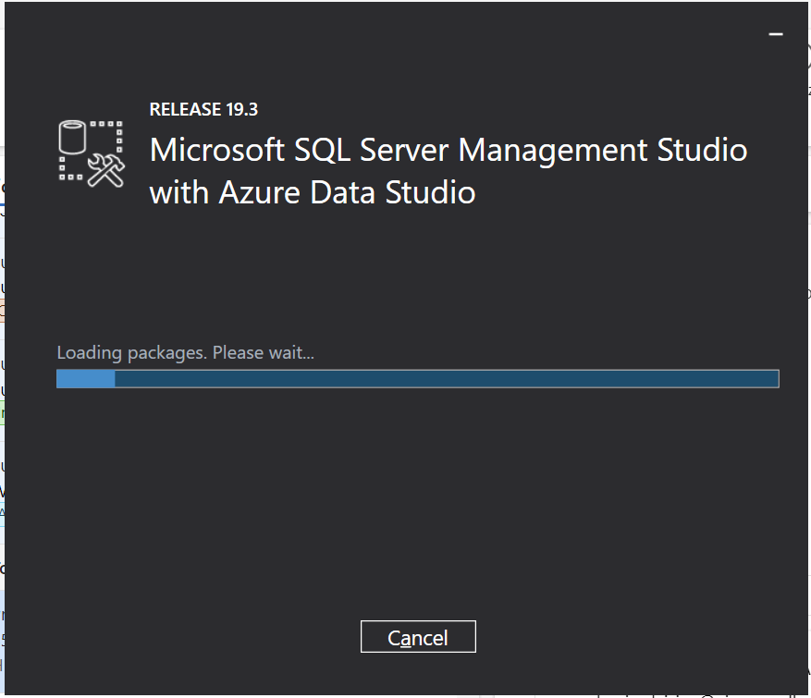

Slide 7
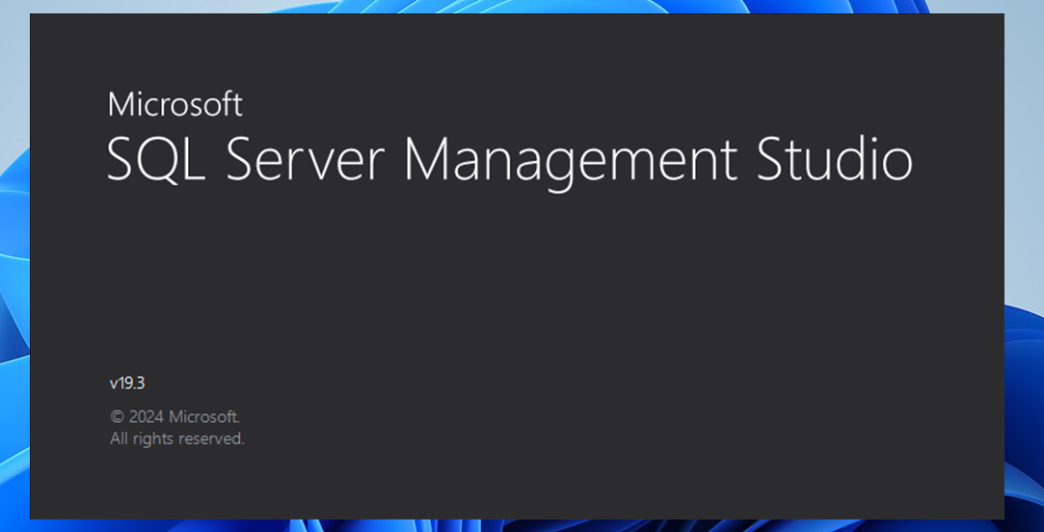

Slide 8
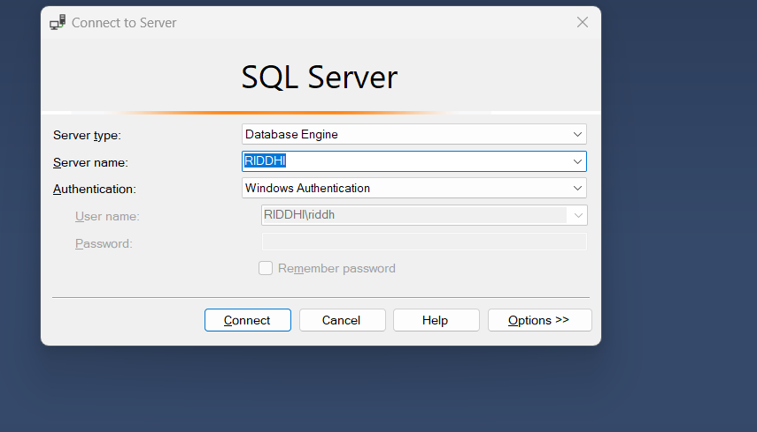

Slide 9
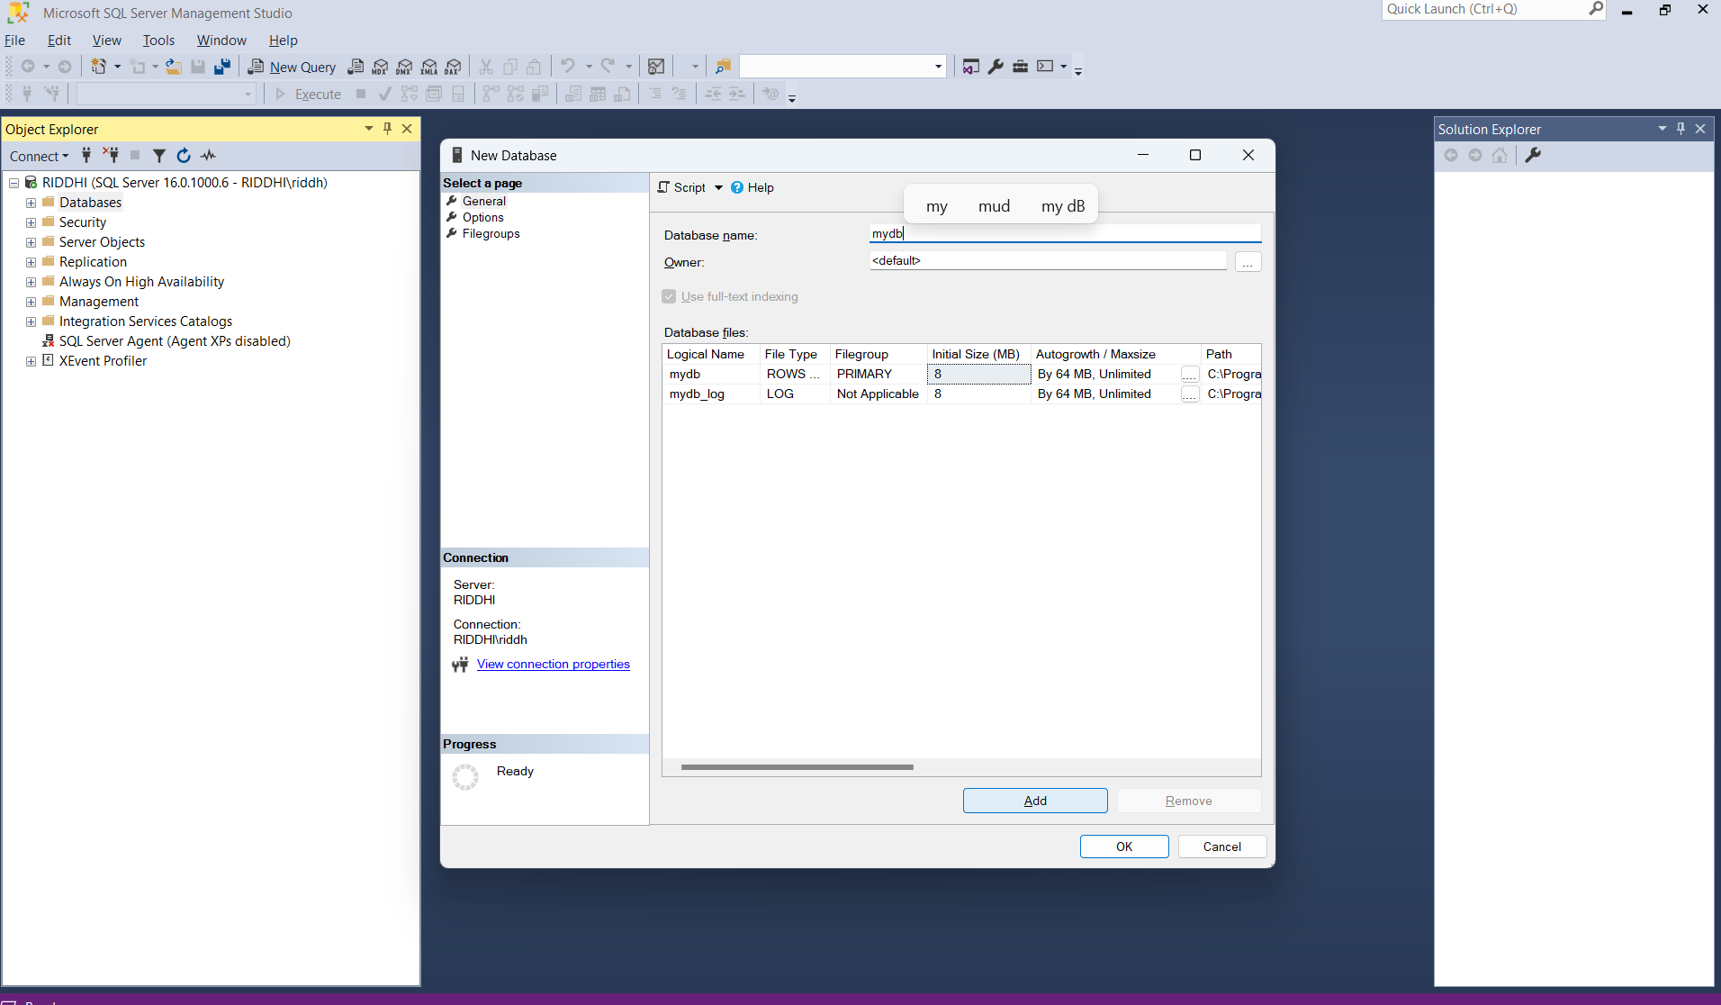

Slide 10
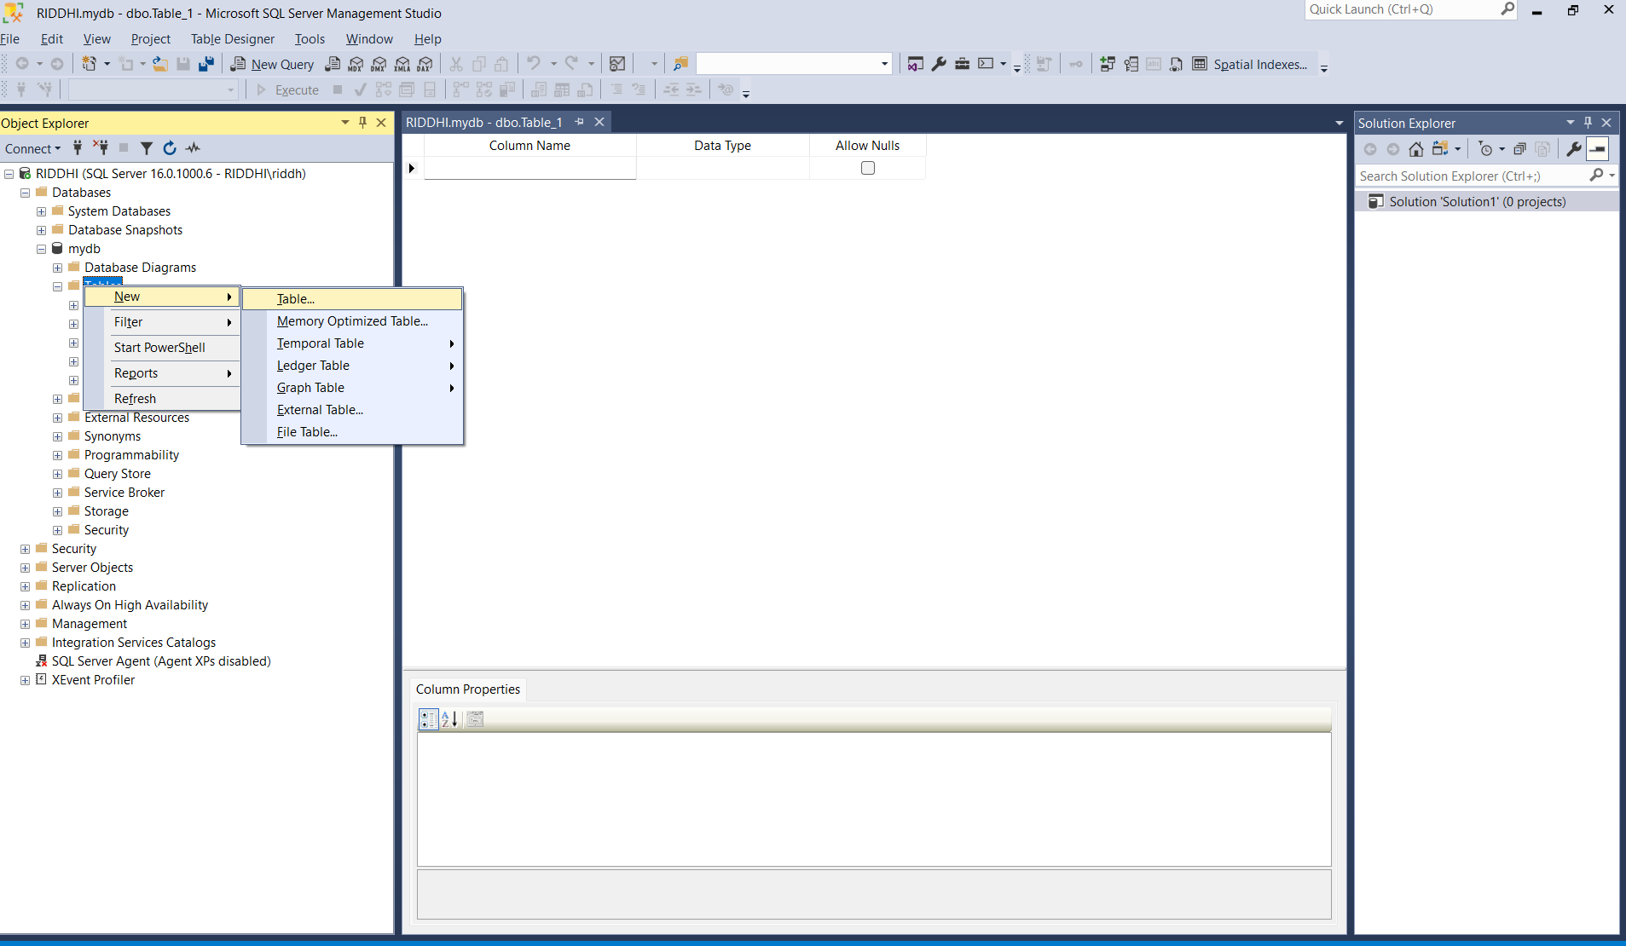

Slide 11
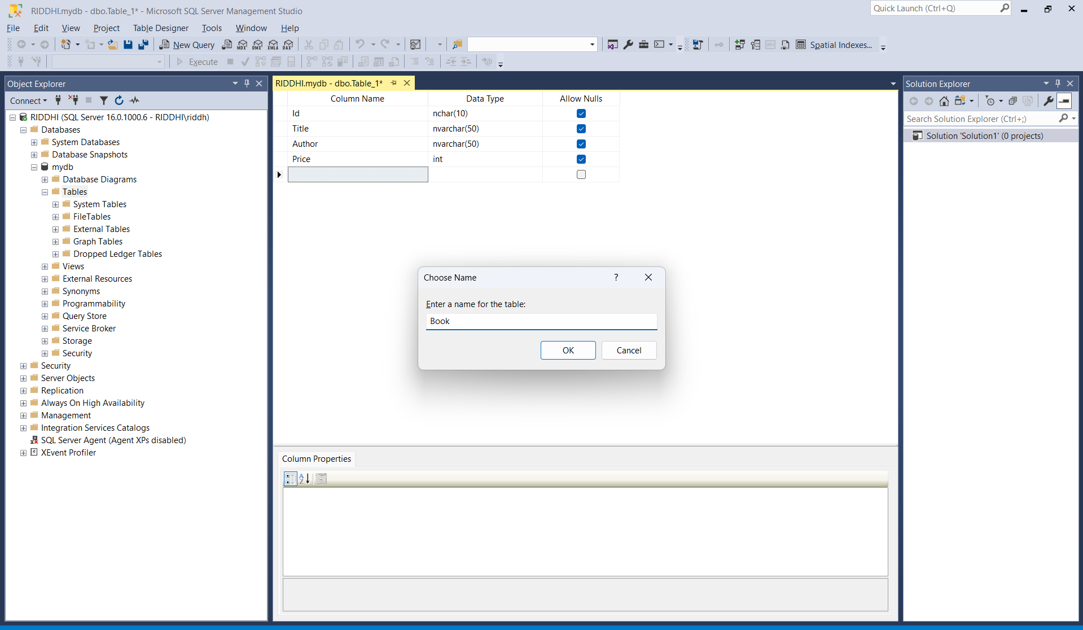

Slide 12
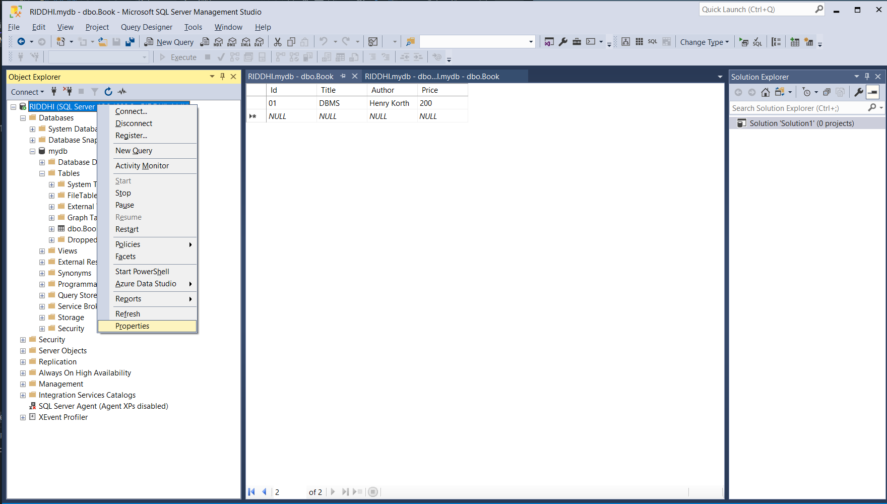

Slide 13
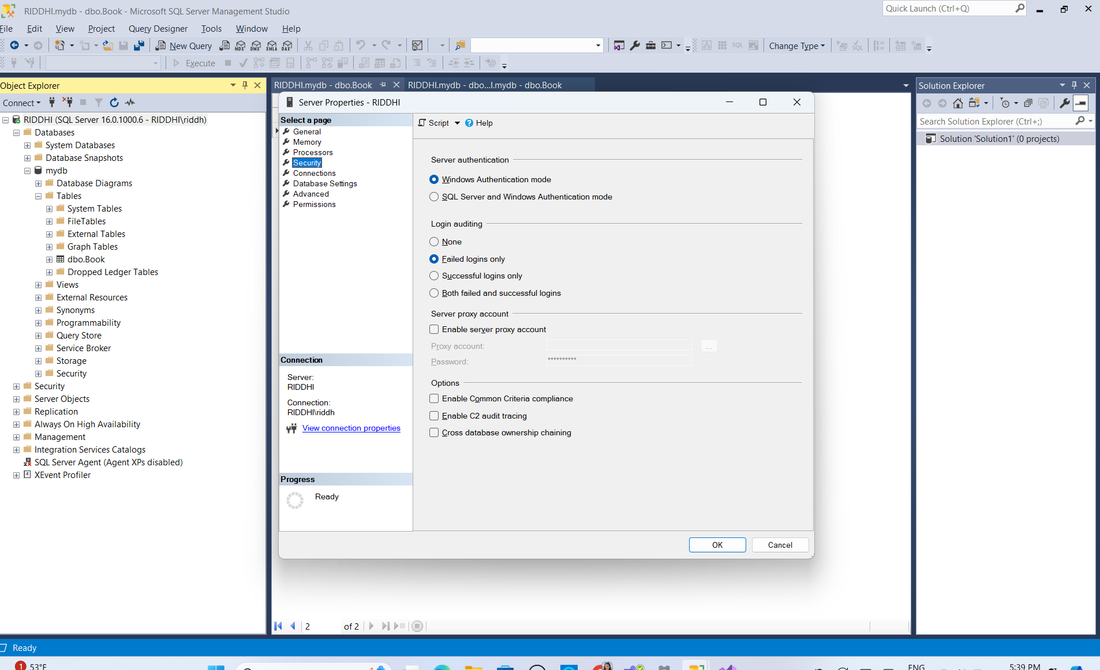

Slide 14
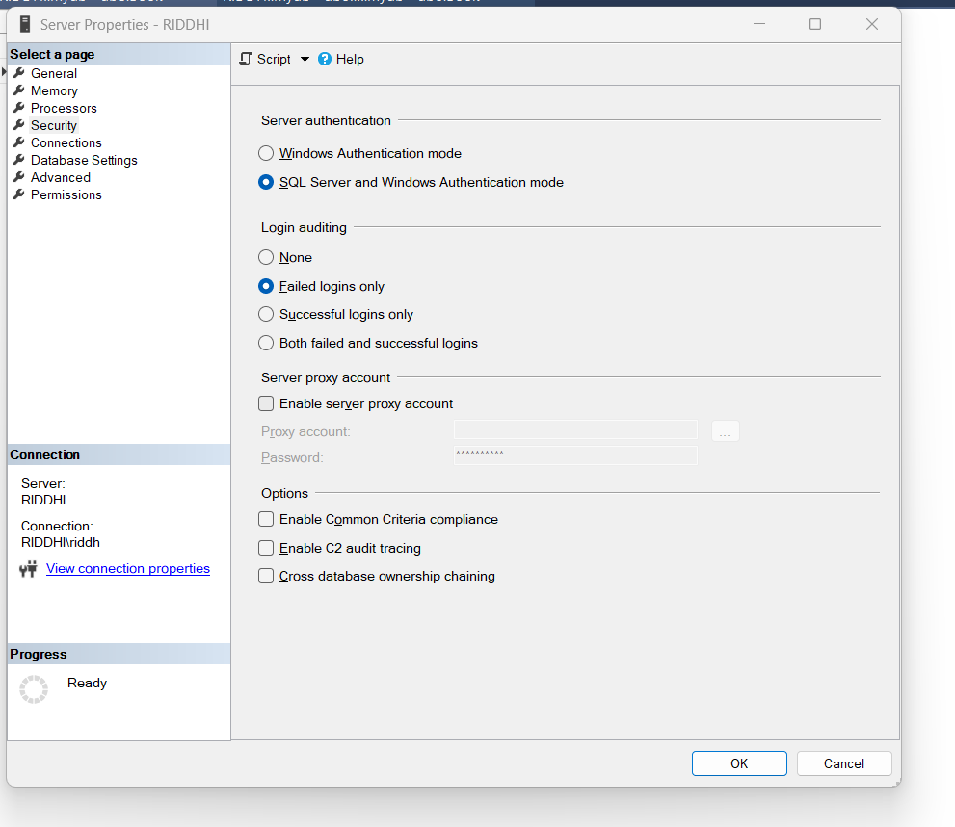

Slide 15
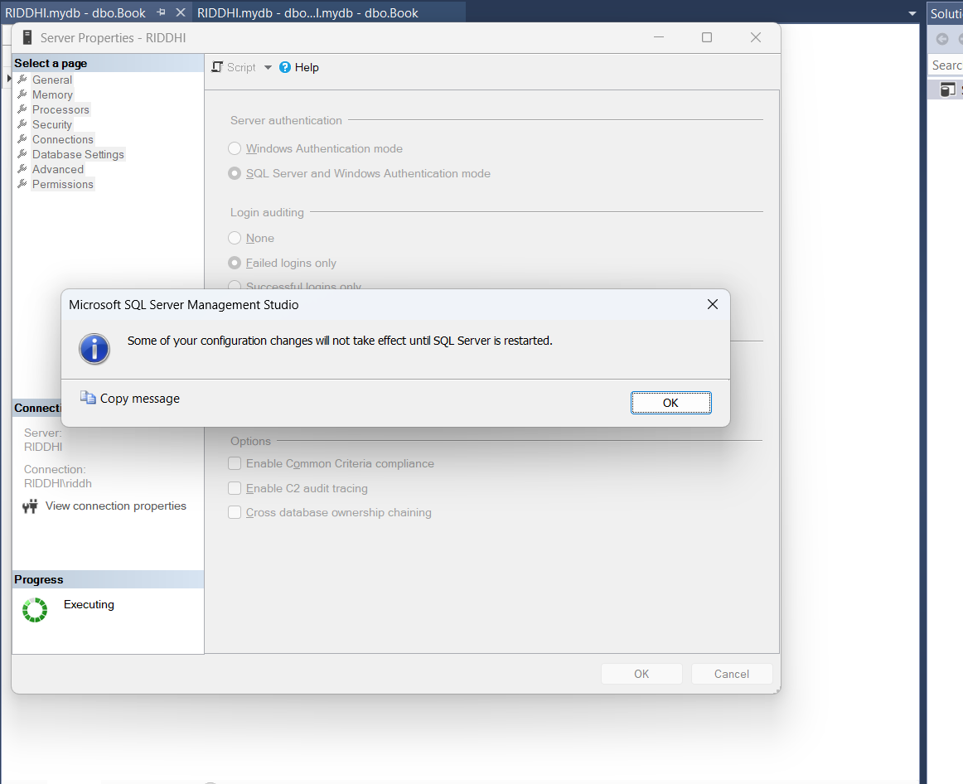

Slide 16
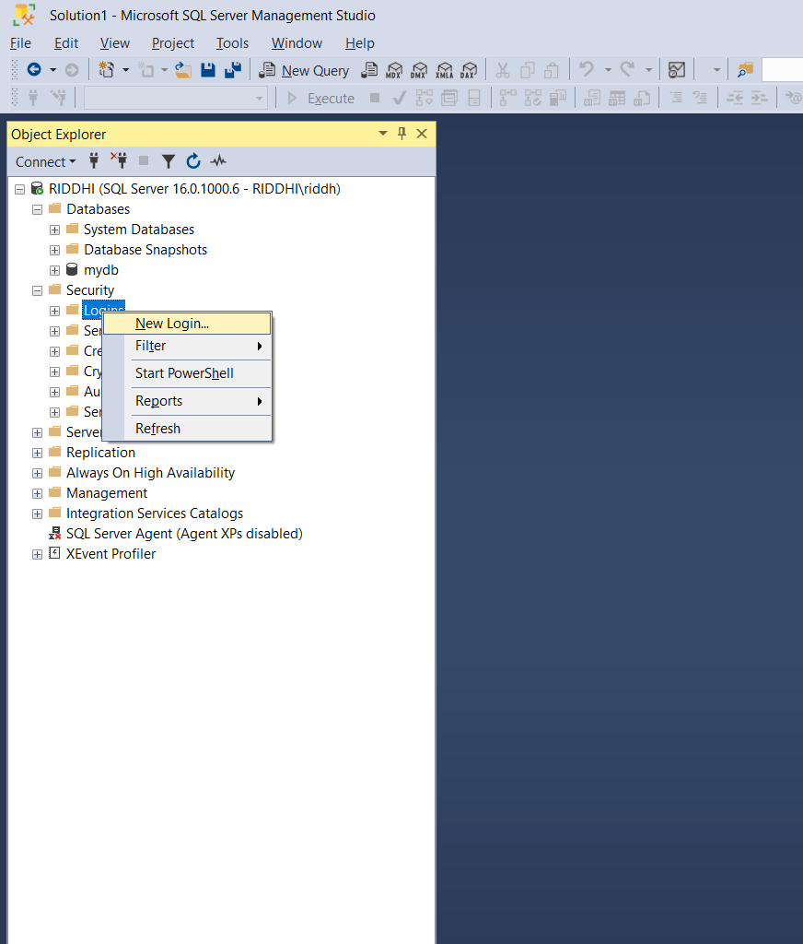

Slide 17
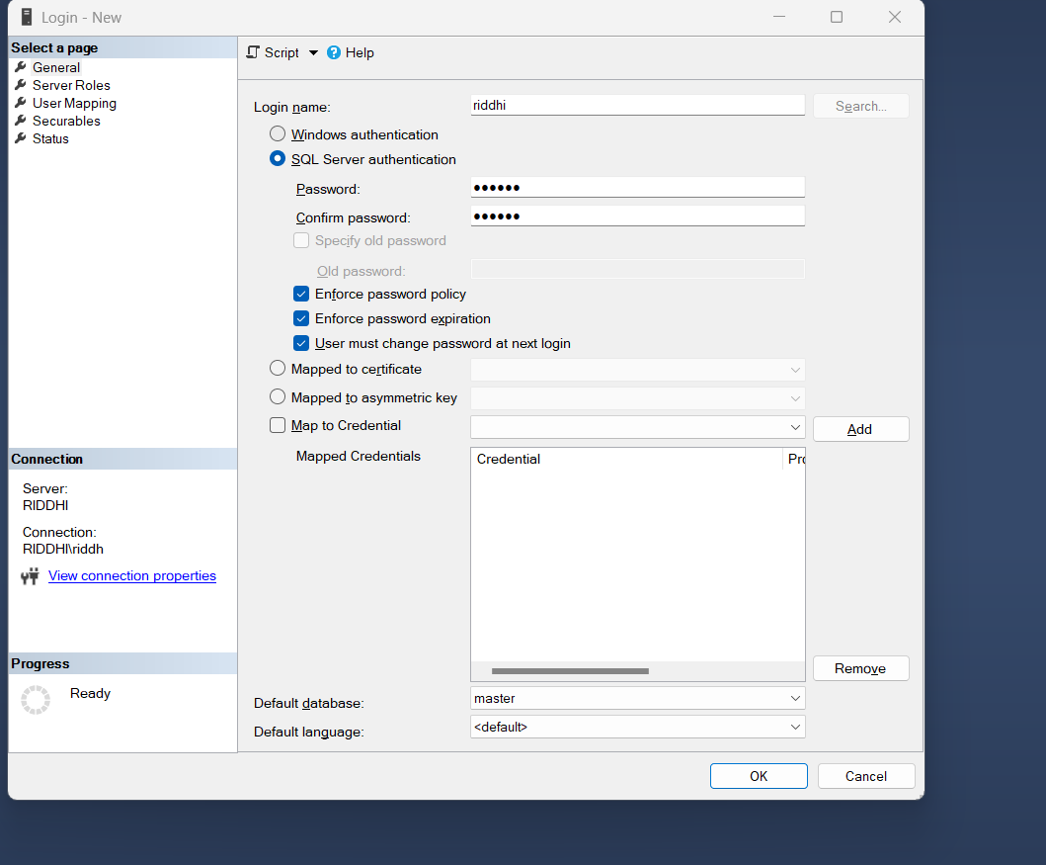

Slide 18
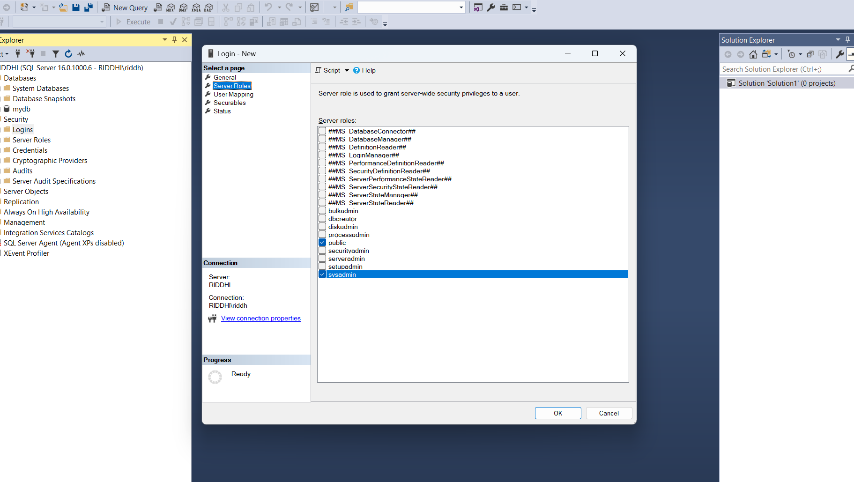

Slide 19
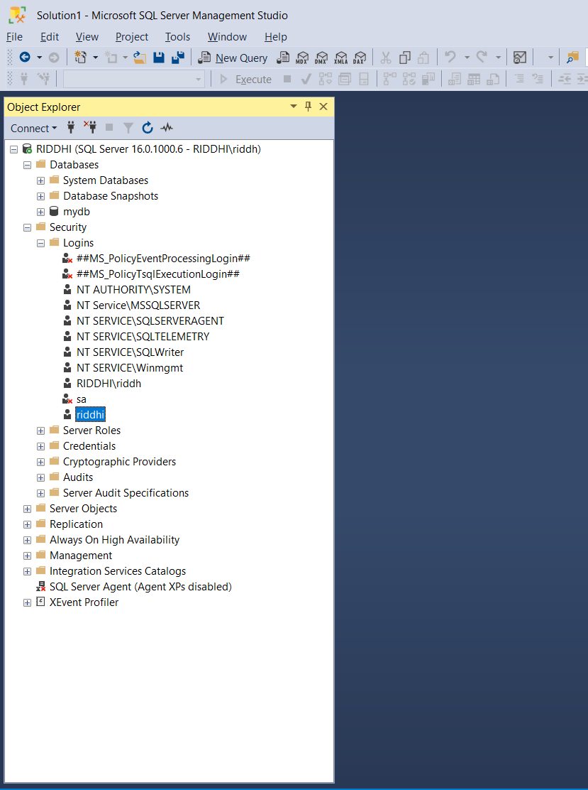

Slide 20
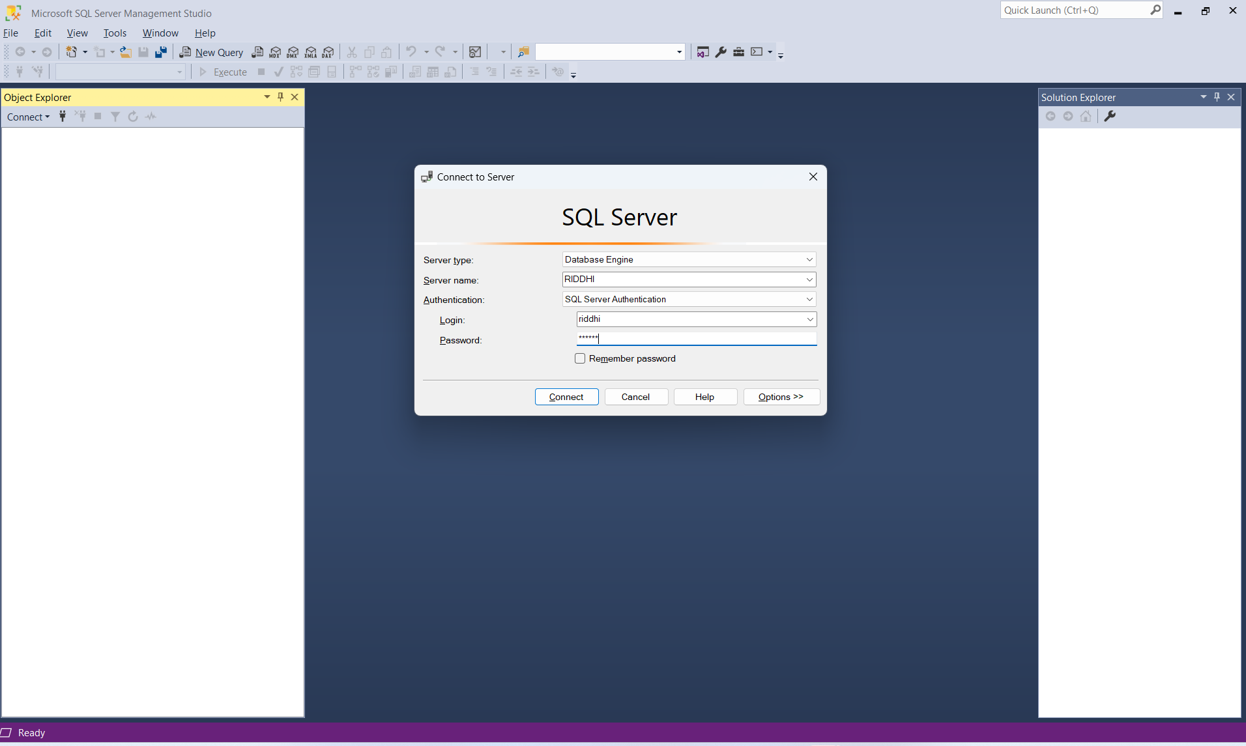

Slide 21
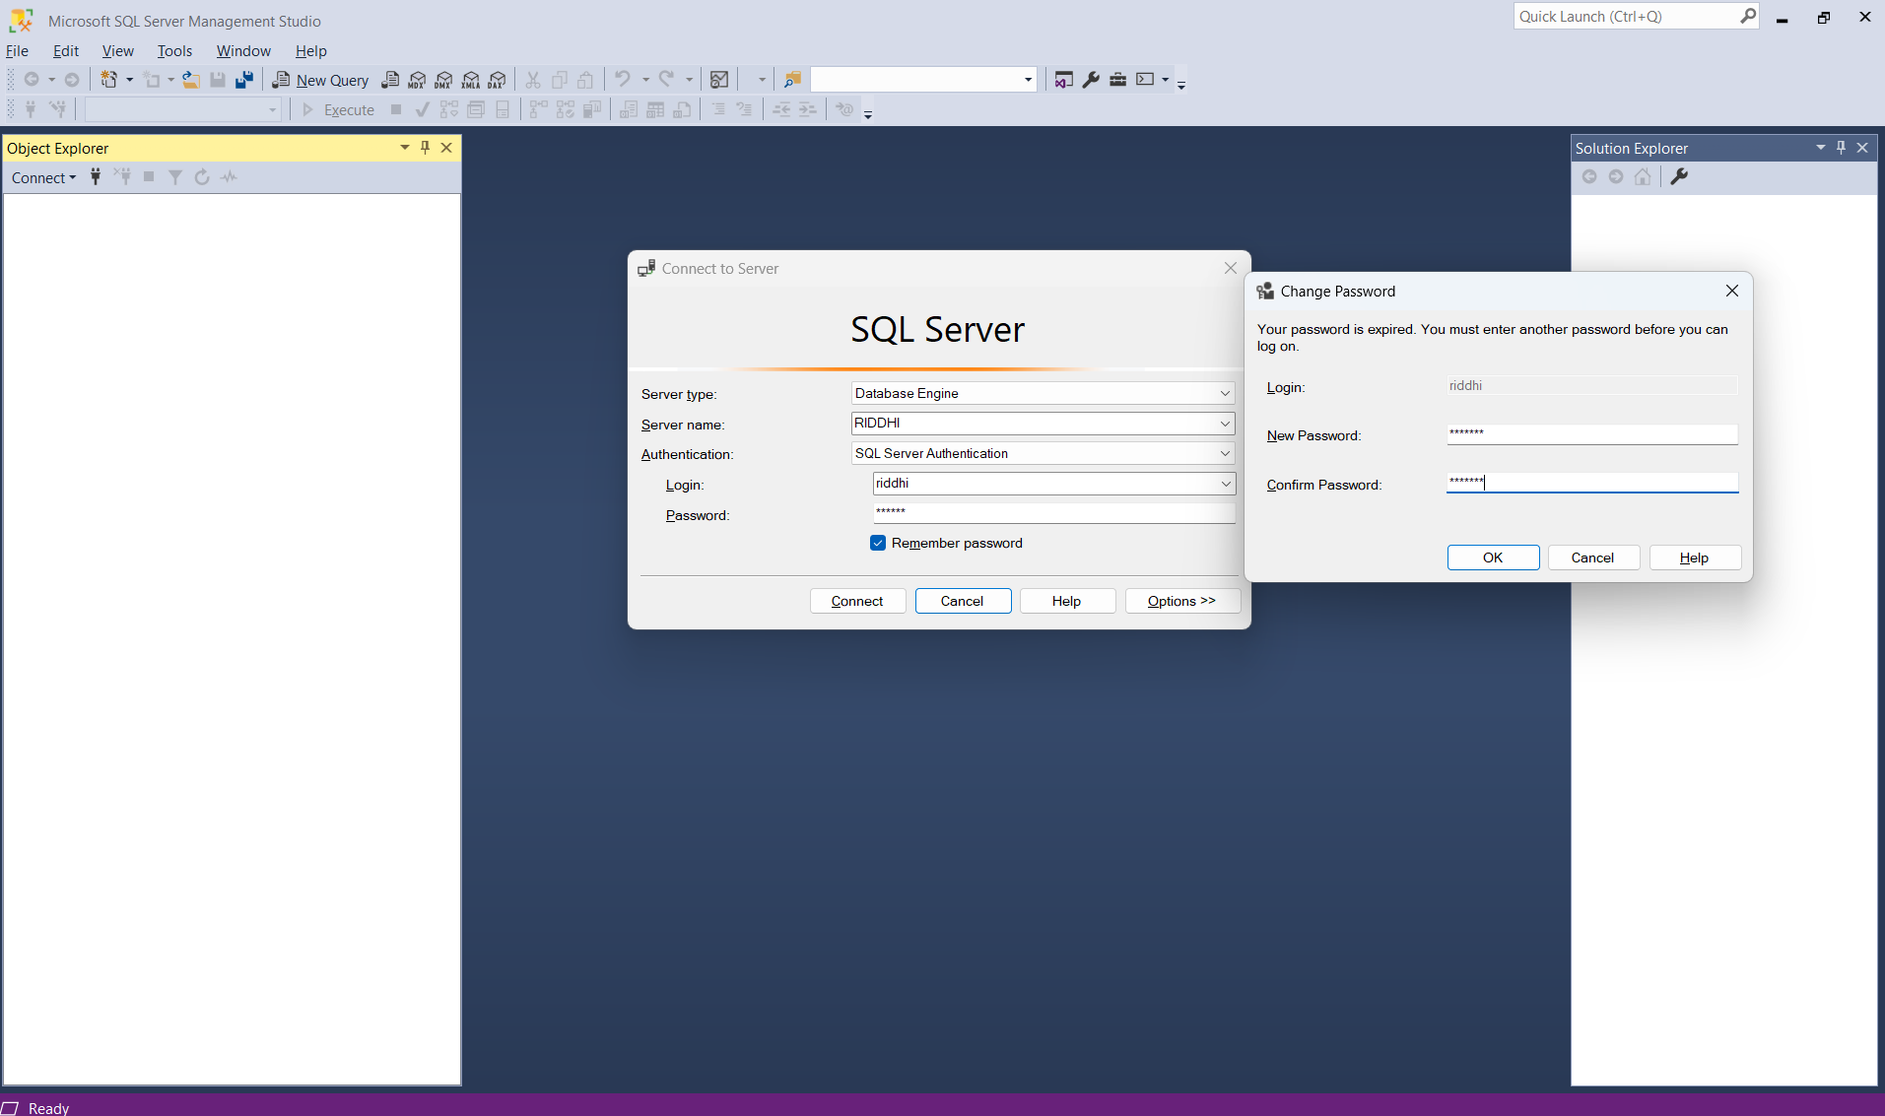

Slide 22
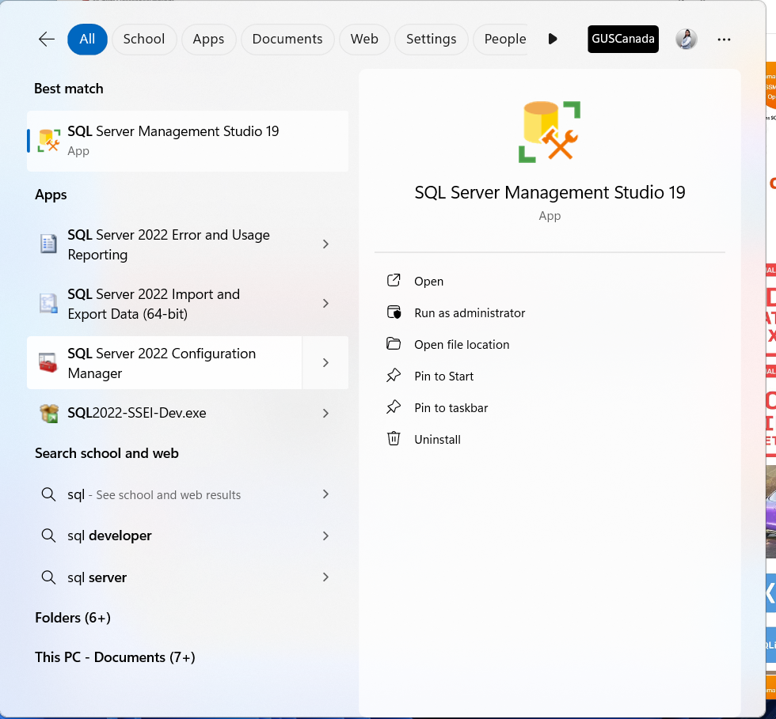

Slide 23
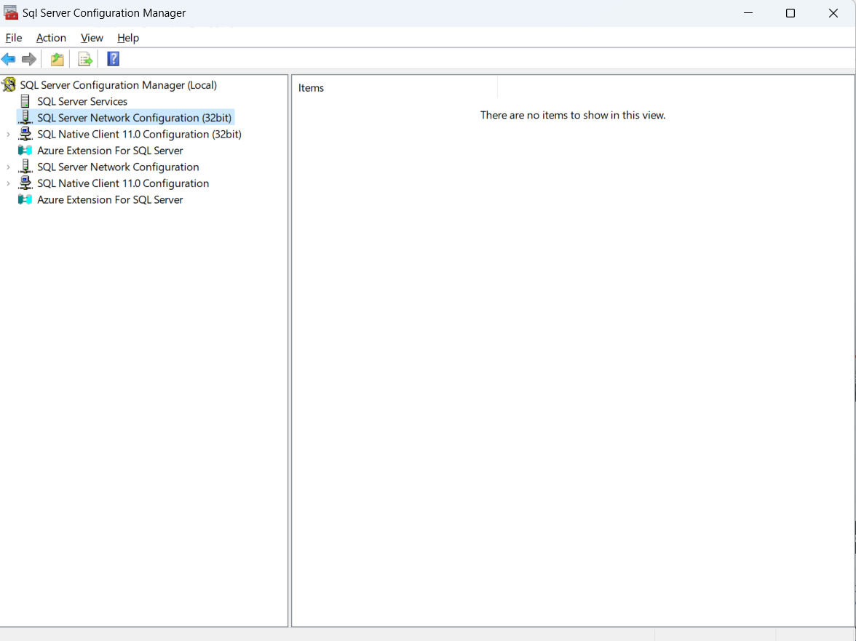

Slide 24
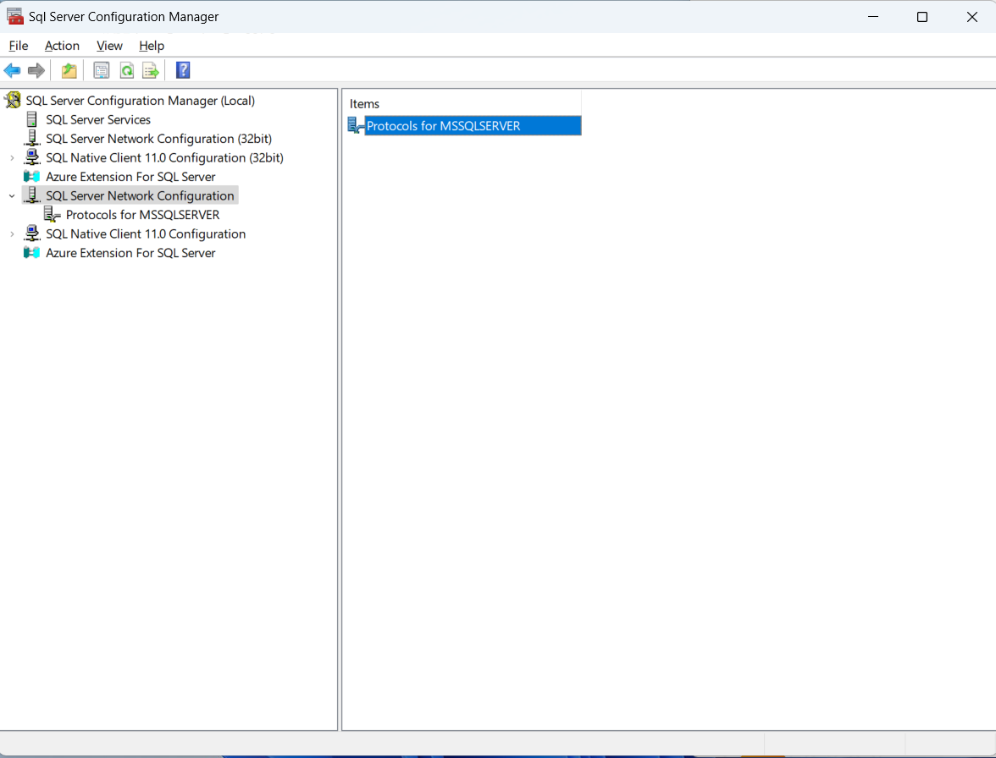

Slide 25
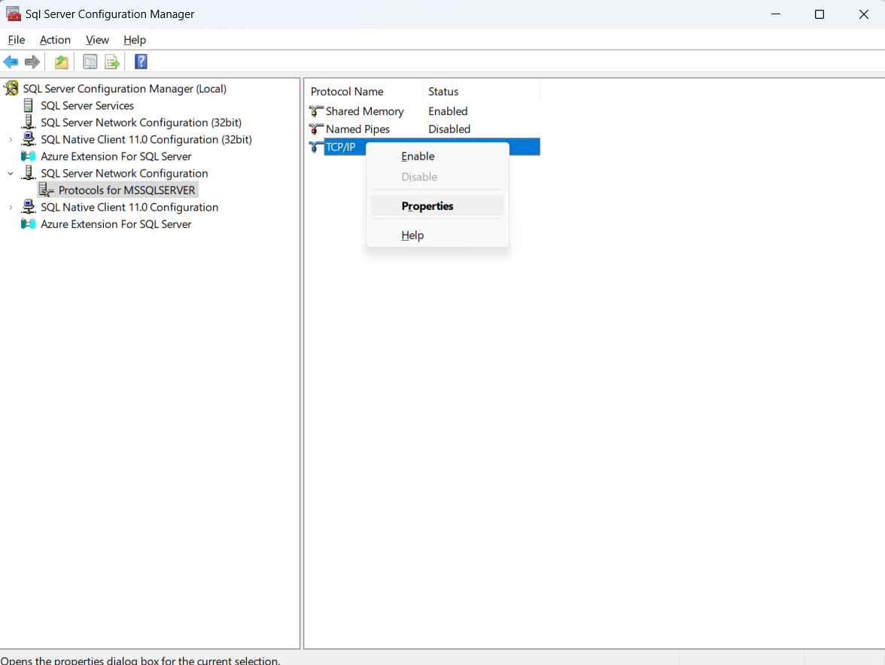

Slide 26
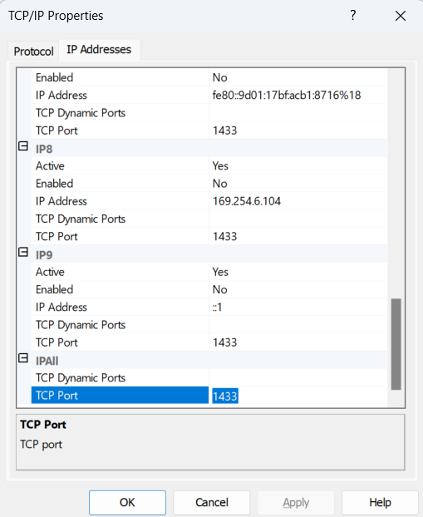

Slide 27
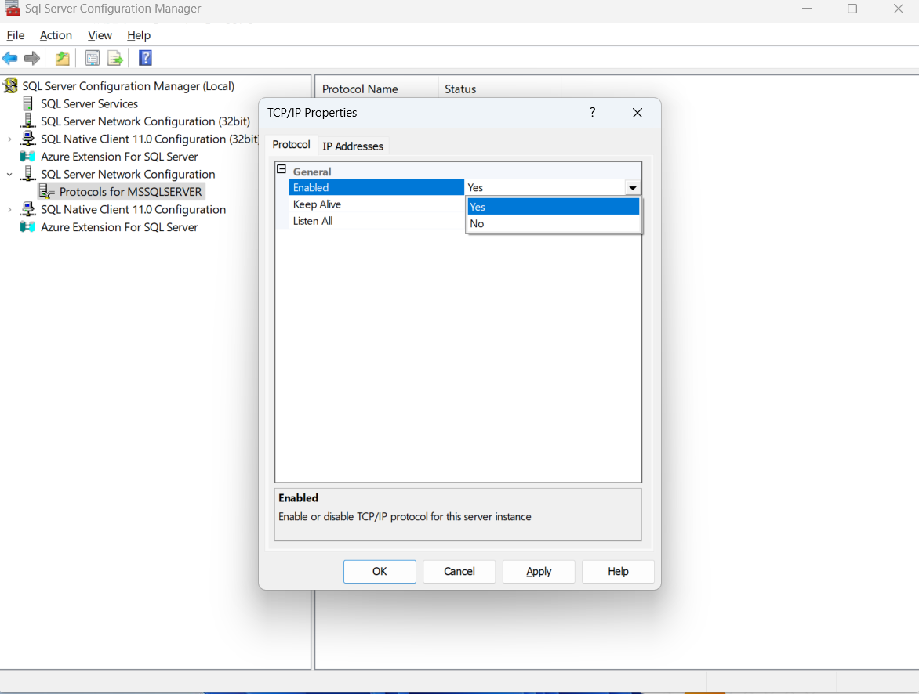

Slide 28
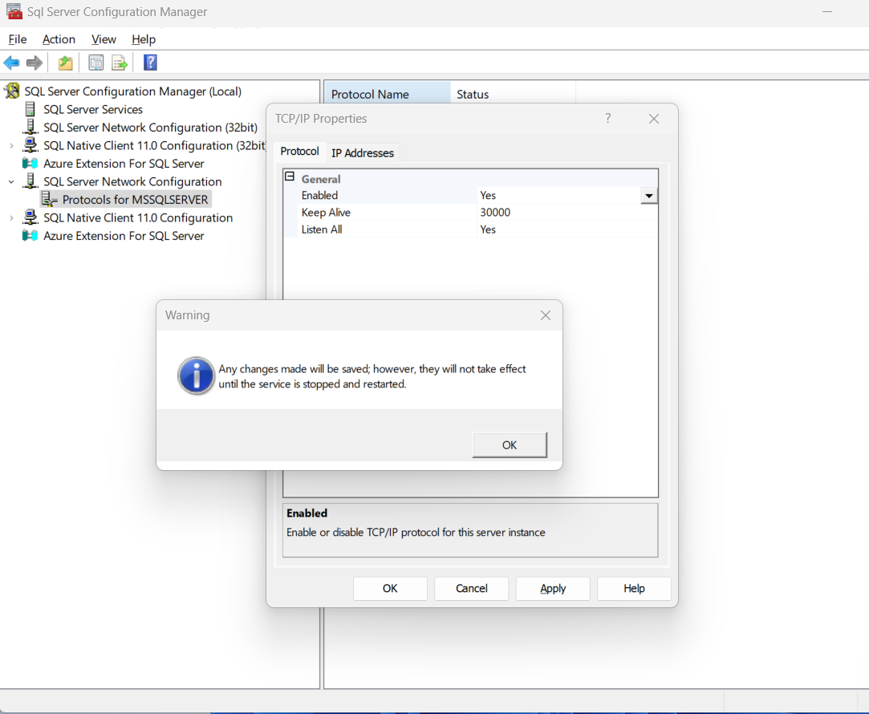

Slide 29
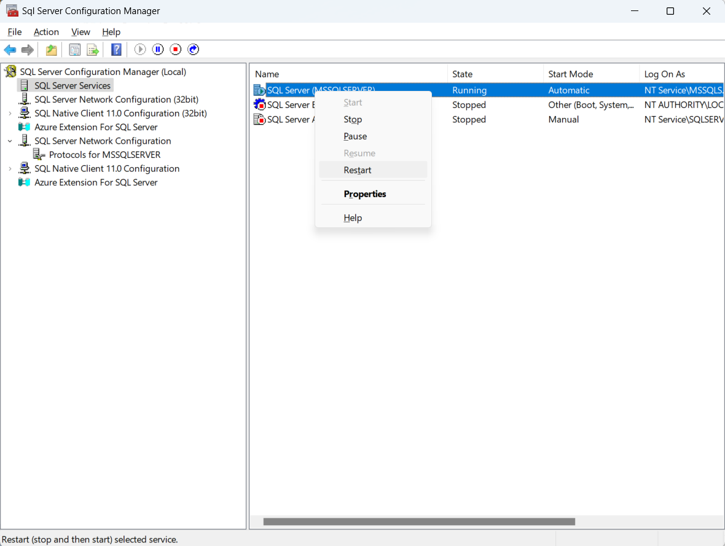

Slide 30
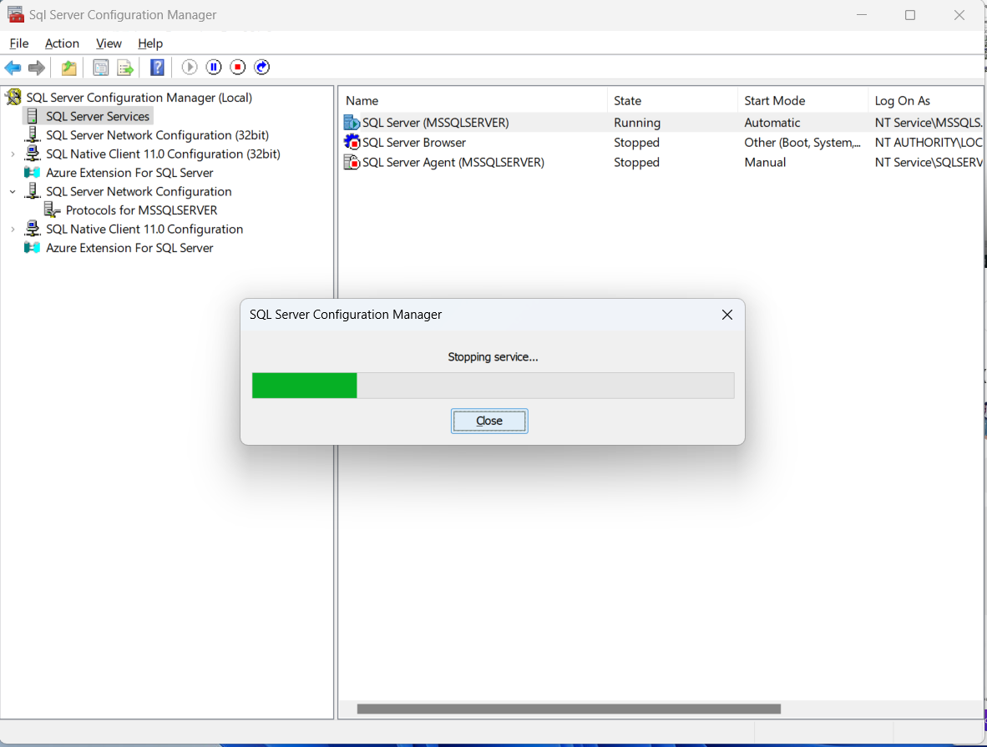

Slide 31
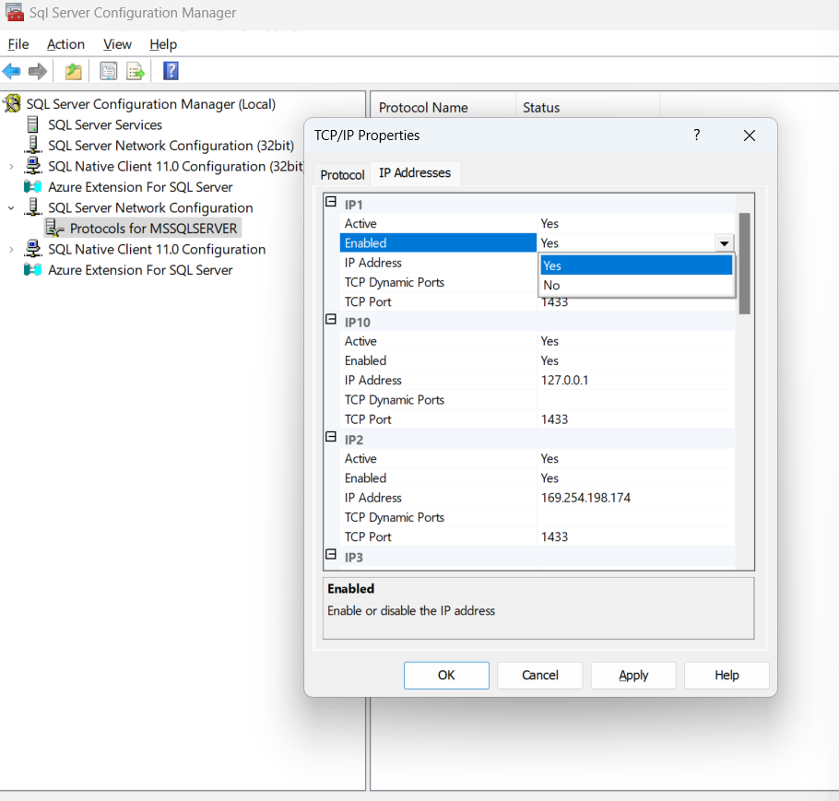
Set all IP as YES

Slide 32
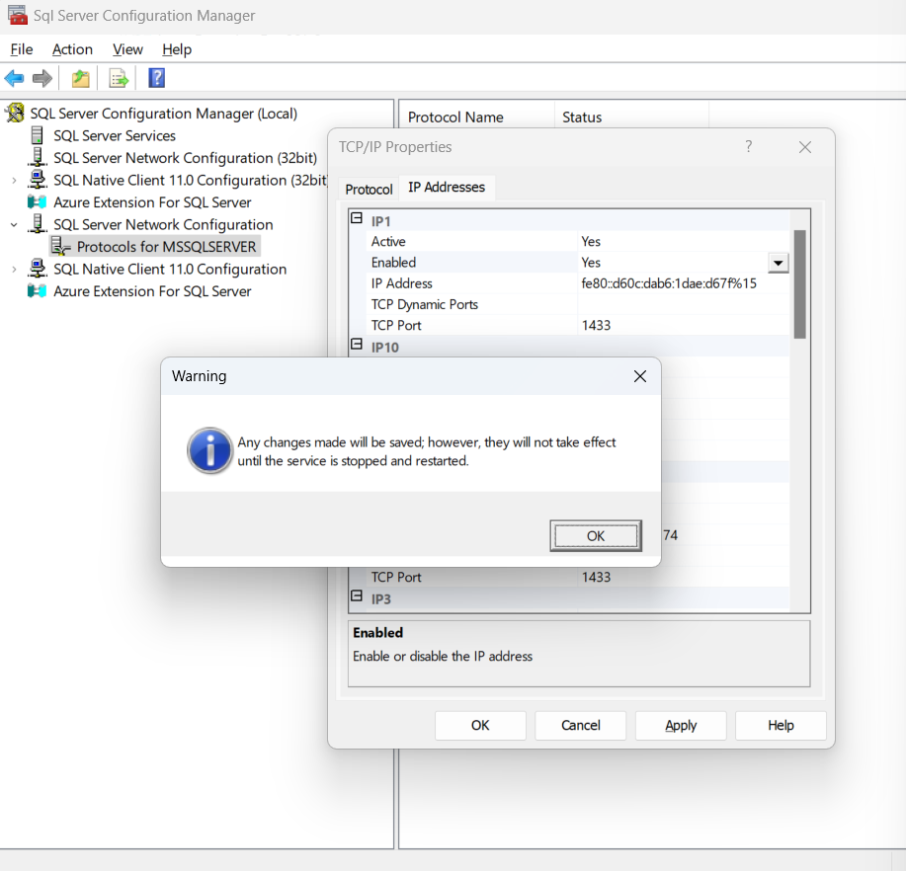

Slide 33
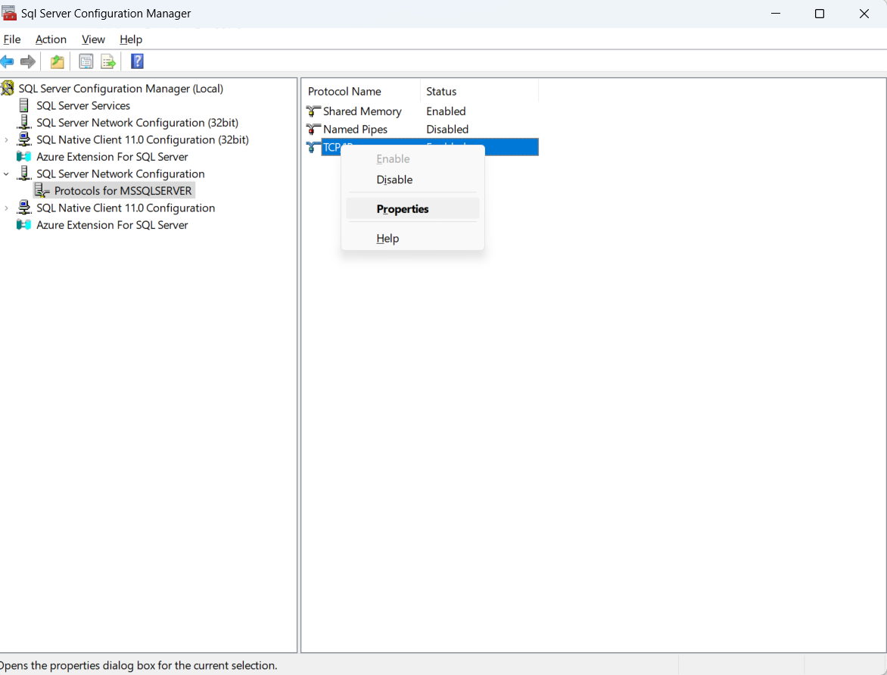

Slide 34
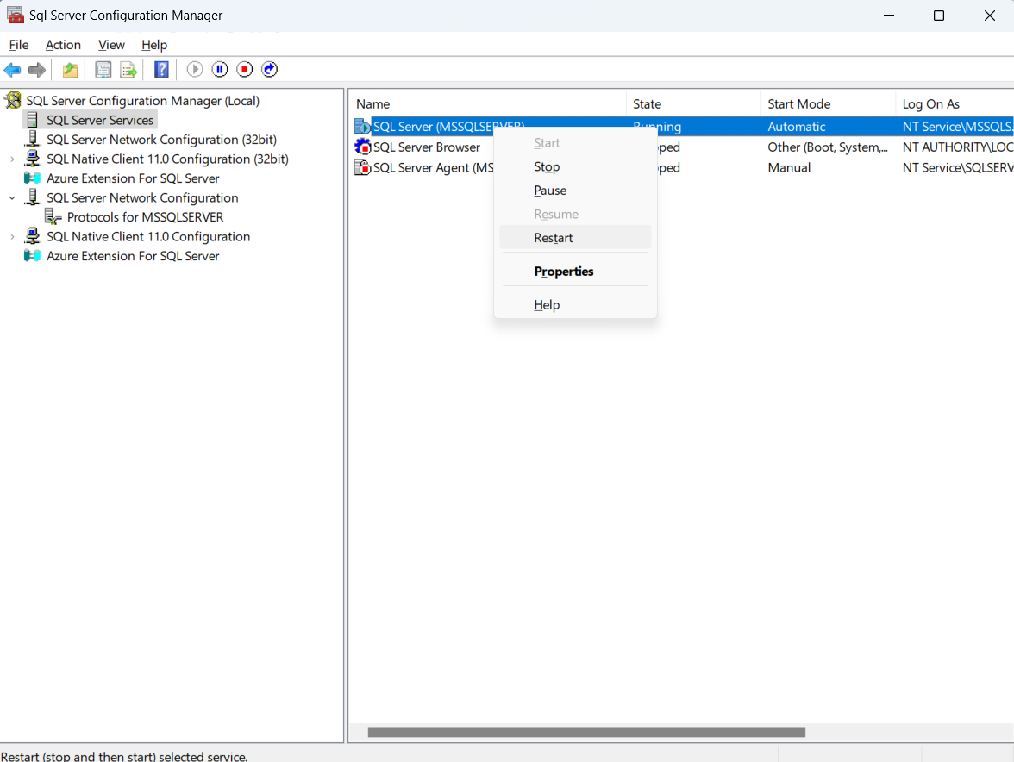

Slide 36
3.2: Introduce MVVM application frameworks for attribute-based page and view model discovery.

Slide 37
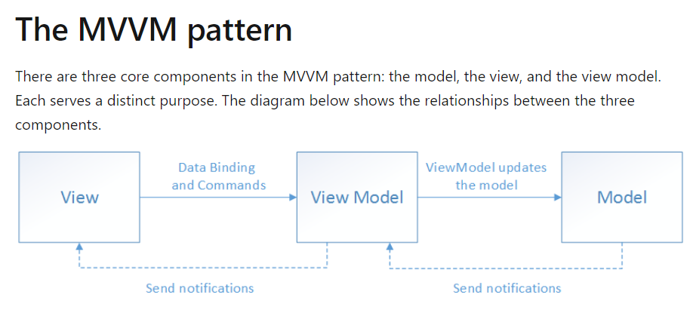
1. Understand MVVM Basics
Model: Contains business logic (data access, parsing, custom logic).
View: Represents the user interface (UI) visible to users.
ViewModel: Prepares data for the UI. Communicates with the View and handles business logic.

Slide 38
Example Scenario (Xamarin.Forms):
Suppose you’re building a mobile inventory management app:
Model: Define data models (e.g., Product, Stock).
ViewModel: Create a ViewModel that handles local data storage (SQLite) and sync logic.
View (XAML): Design screens for adding/editing products and viewing stock levels.
Implement sync logic using background tasks and handle conflicts.

Slide 39
The benefits of using the MVVM pattern are as follows:
If an existing model implementation encapsulates existing business logic, it can be difficult or risky to change it. In this scenario, the view model acts as an adapter for the model classes and prevents you from making major changes to the model code.
Developers can create unit tests for the view model and the model, without using the view. The unit tests for the view model can exercise exactly the same functionality as used by the view.
The app UI can be redesigned without touching the view model and model code, provided that the view is implemented entirely in XAML or C#. Therefore, a new version of the view should work with the existing view model.
Designers and developers can work independently and concurrently on their components during development. Designers can focus on the view, while developers can work on the view model and model components.

Slide 40
2. Create Your Solution
Open Visual Studio or Visual Studio for Mac.
Create a new Xamarin.Forms or .NET MAUI solution.
Choose the appropriate project template (e.g., Blank, Master-Detail, Tabbed Page).
3. Define Your Models
Create classes that represent your data (e.g., Student, Course).
Add properties and methods for data manipulation.
4. Create ViewModel Classes
For each View (UI screen), create a corresponding ViewModel class.
ViewModel prepares data for the View.
Implement INotifyPropertyChanged for property change notifications.
Example ViewModel for a Student:

Slide 41
Xamarin –Mobile applications.
Mobile Application
2) Blank

Slide 42
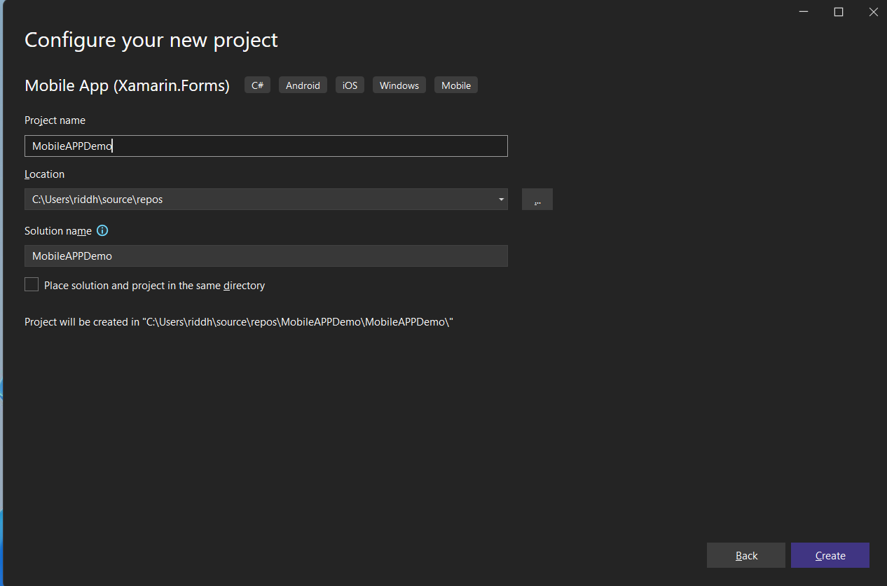

Slide 43
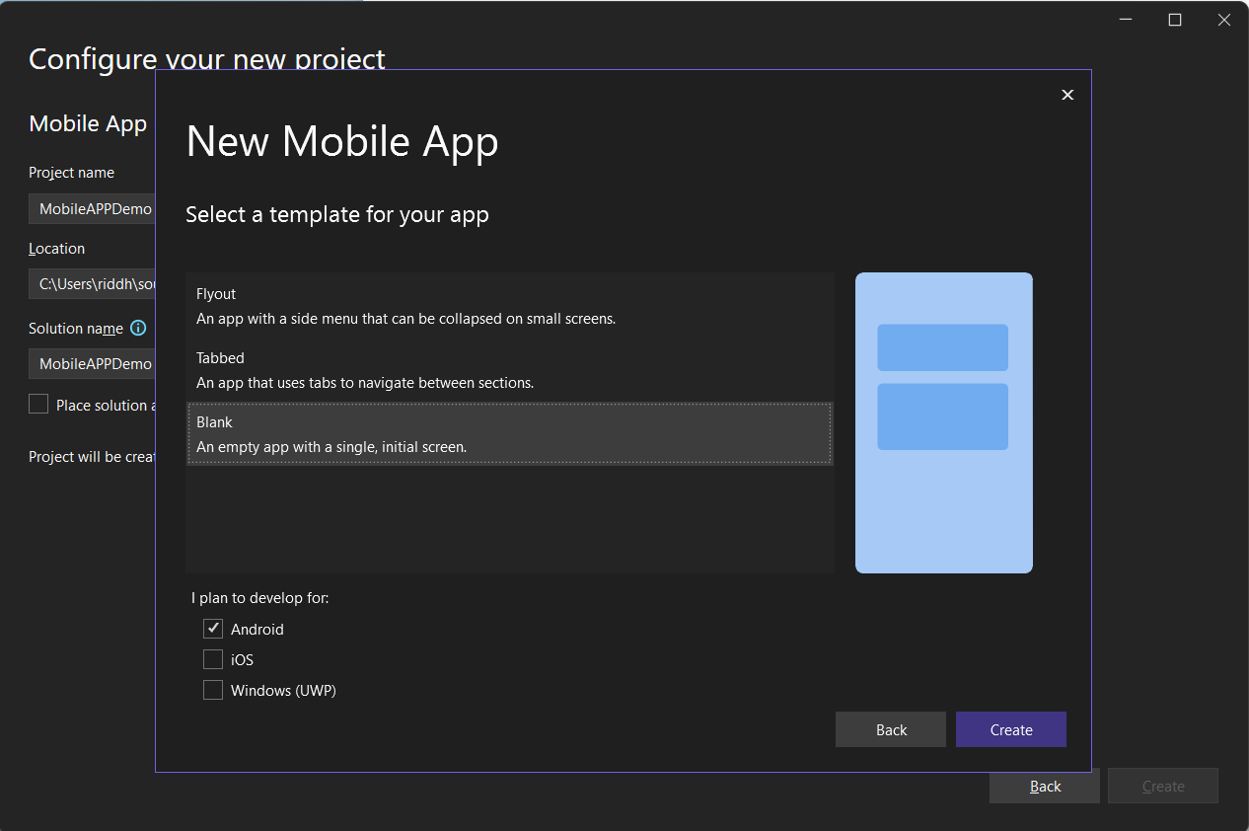

Slide 44
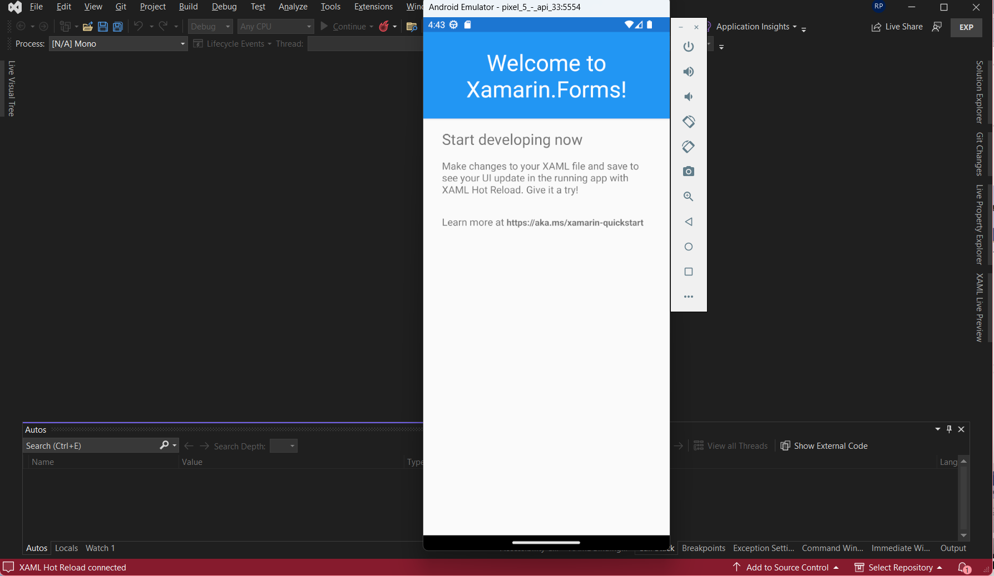

Slide 45
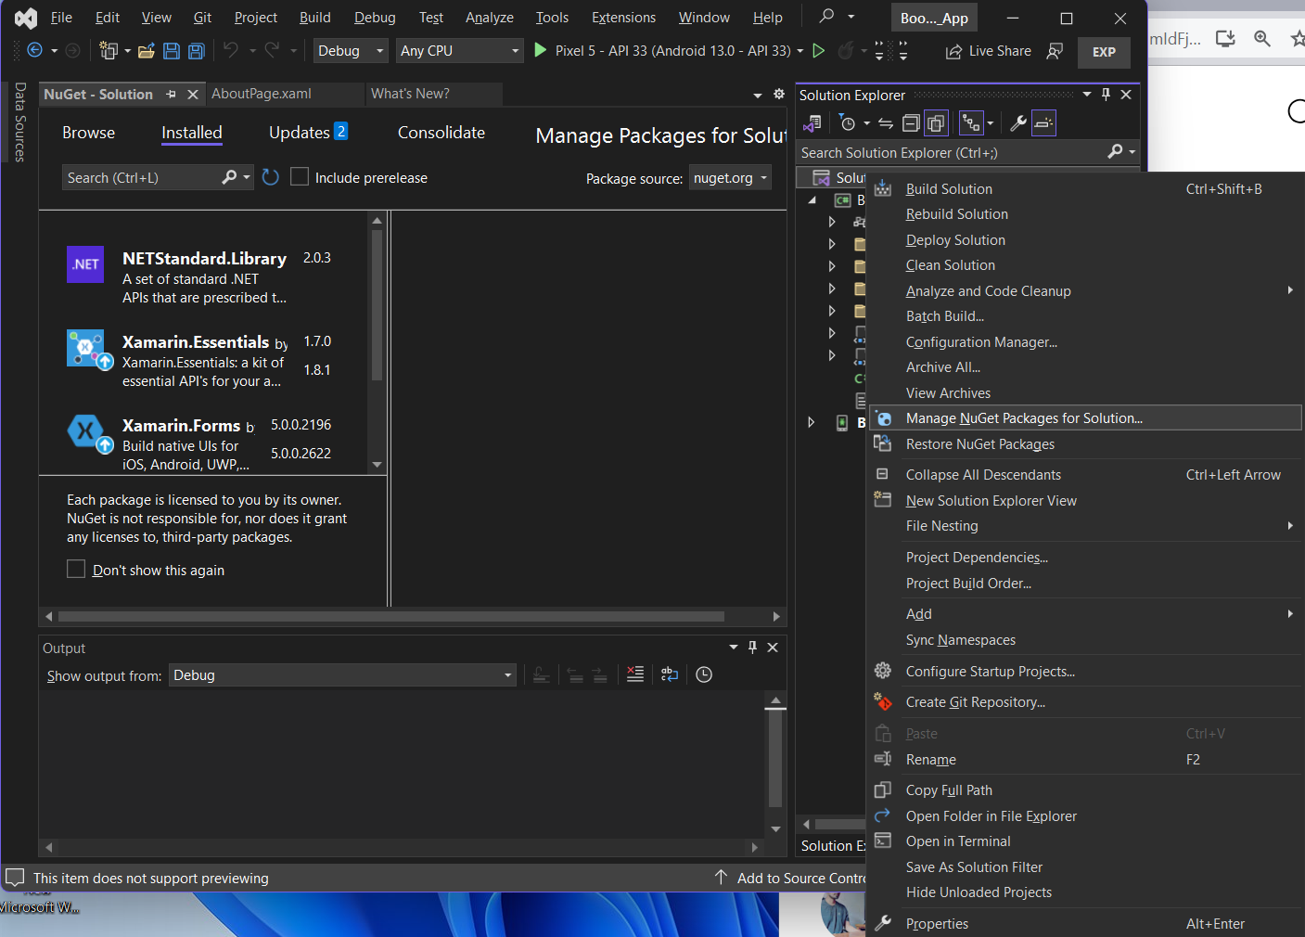

Slide 46
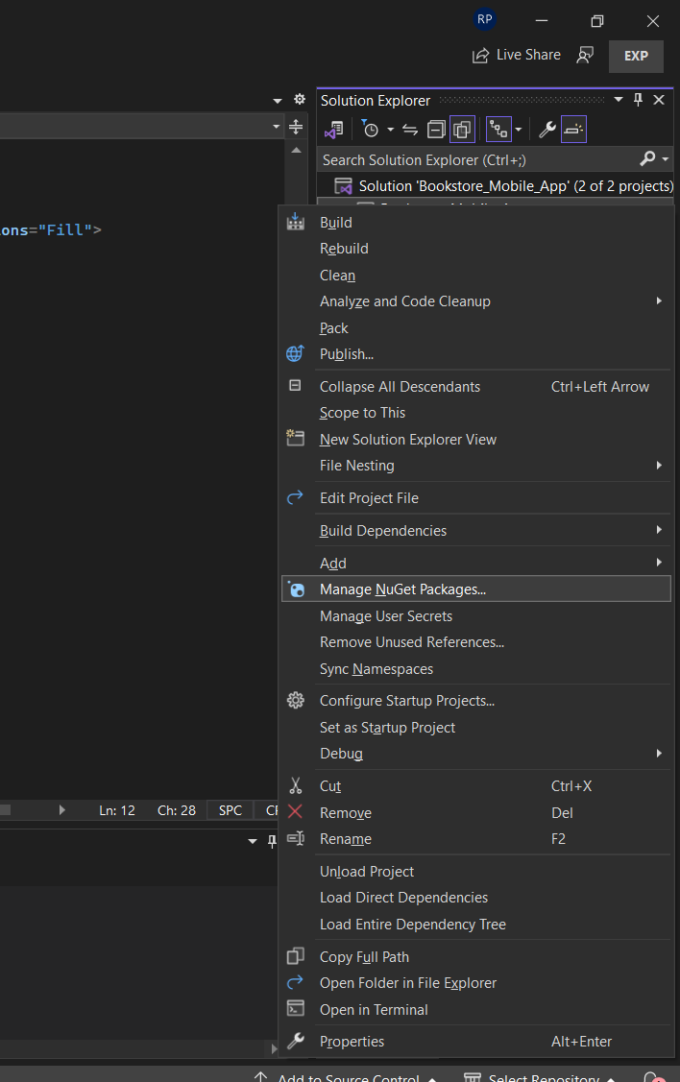

Slide 47
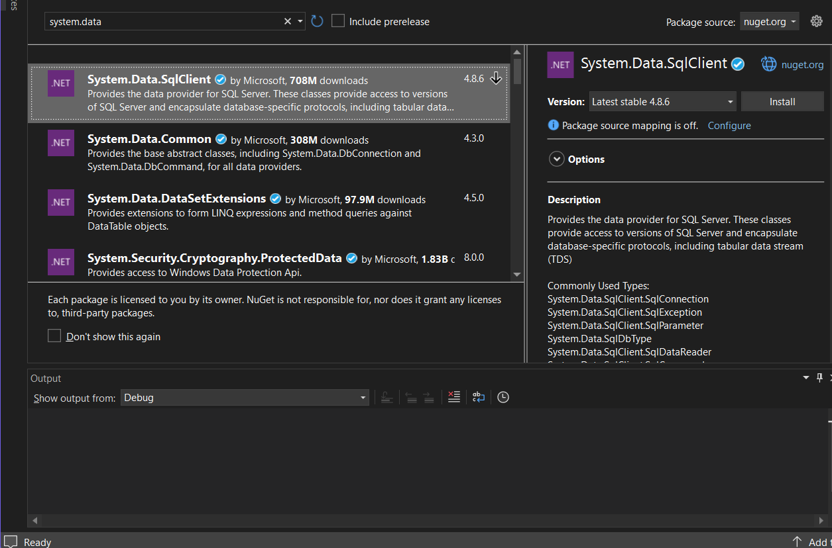

Slide 48
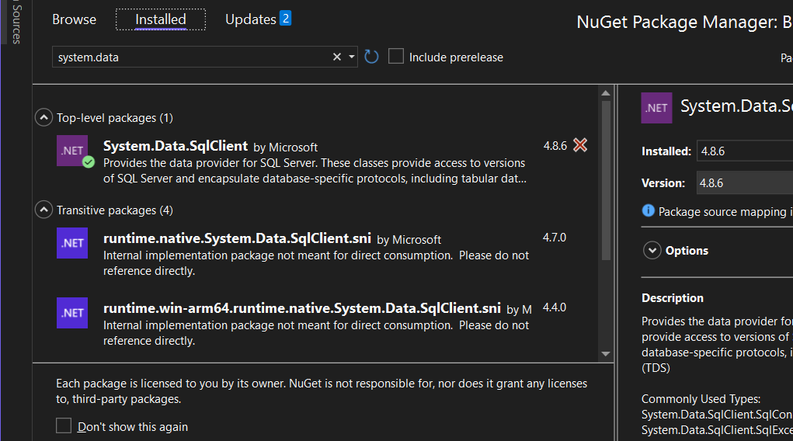

Slide 49
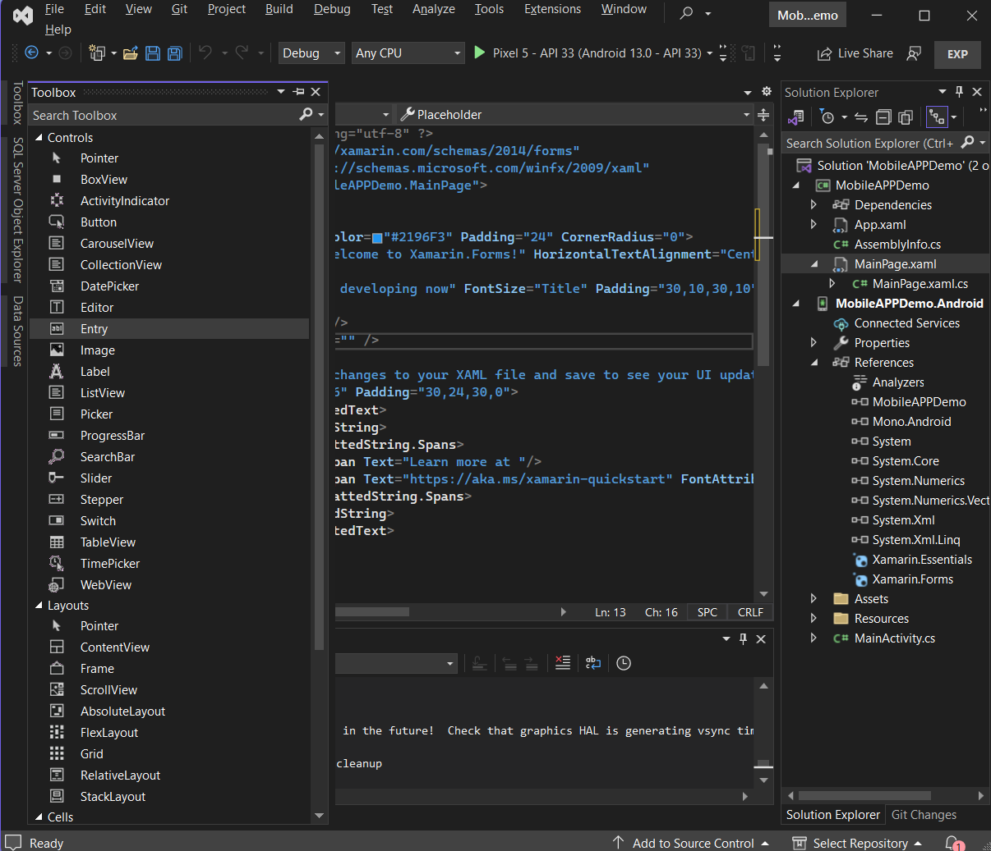

Slide 50
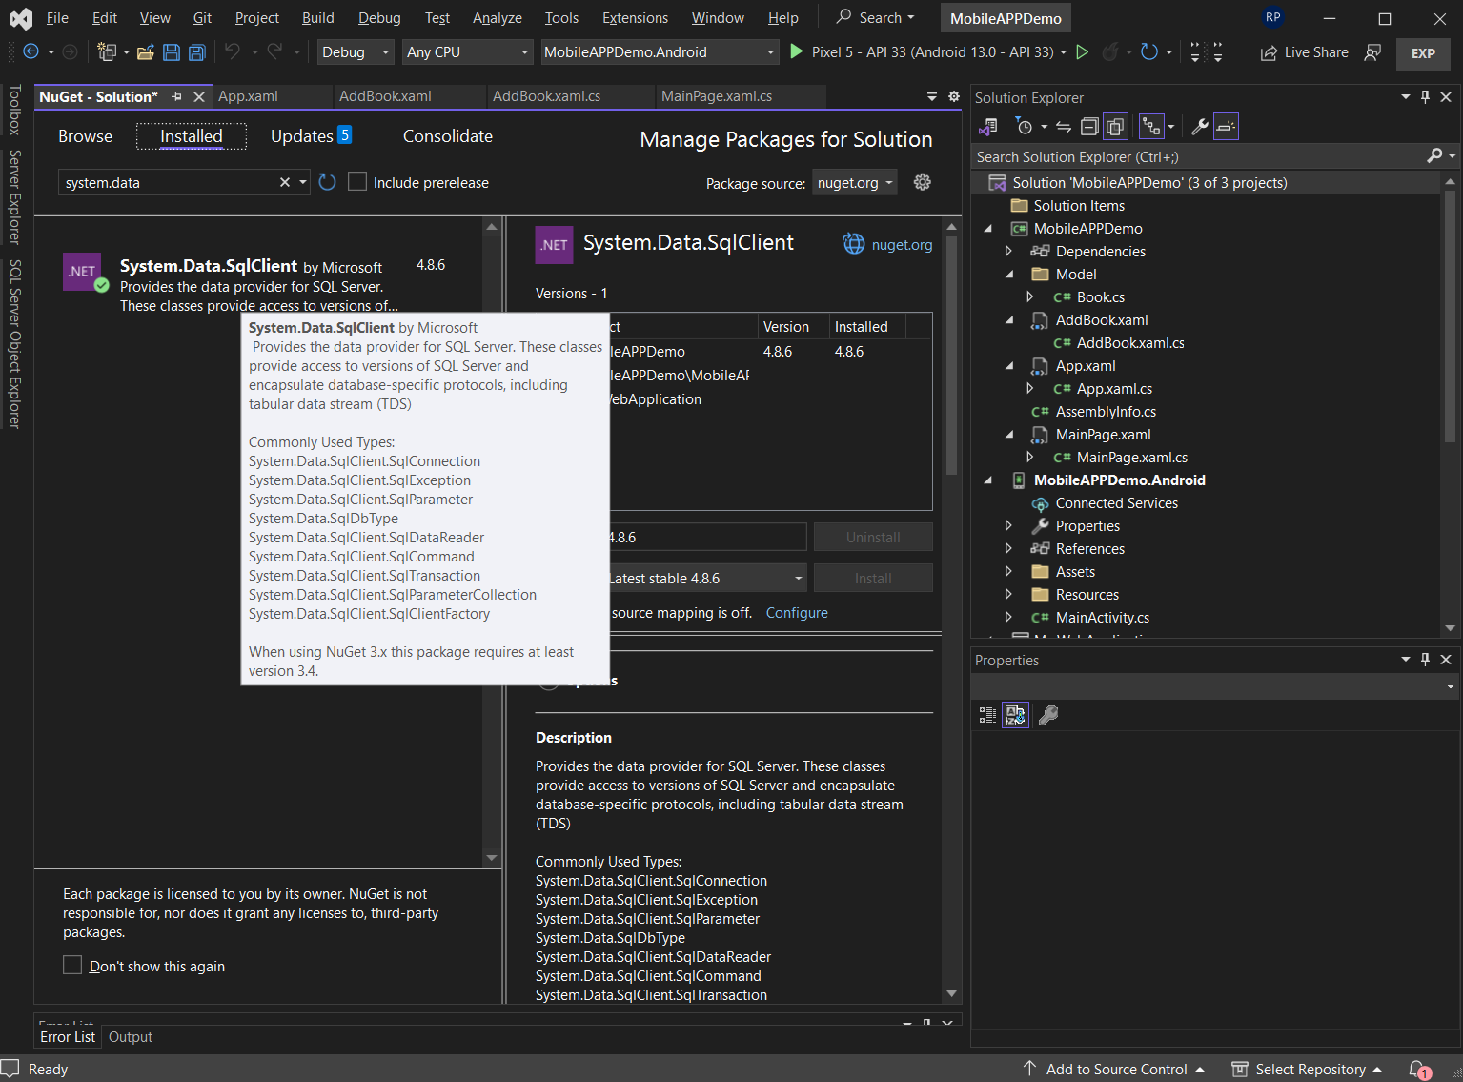

Slide 51
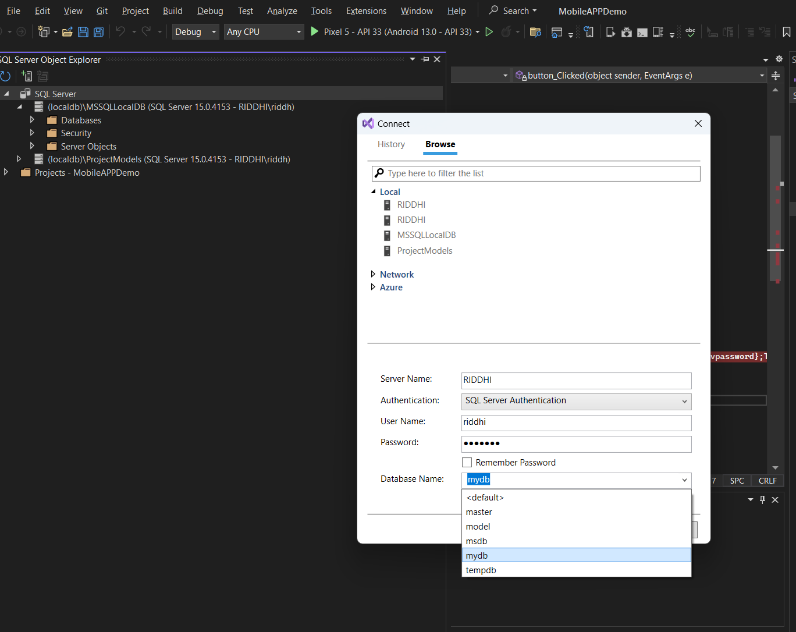

Slide 52
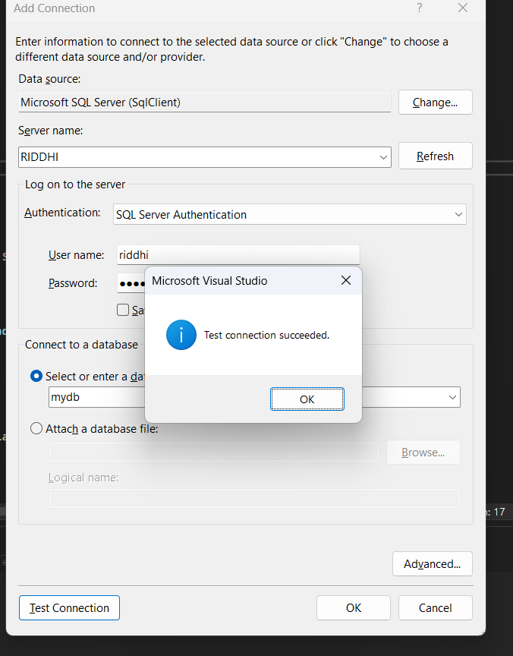

Slide 53
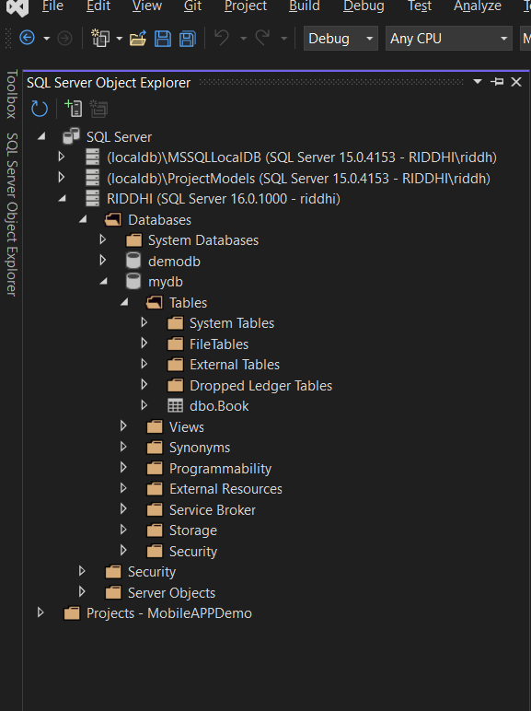

Slide 54
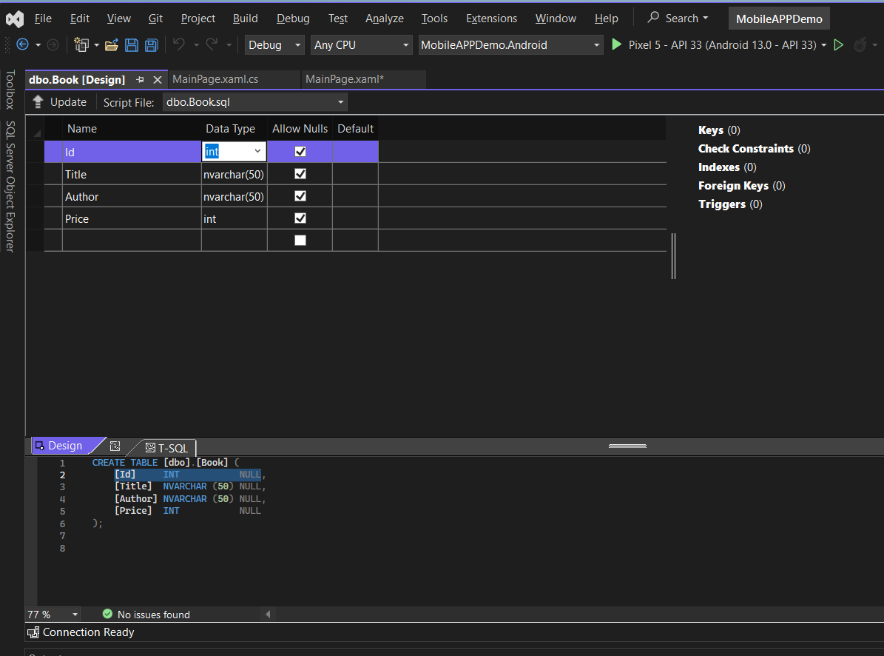

Slide 55
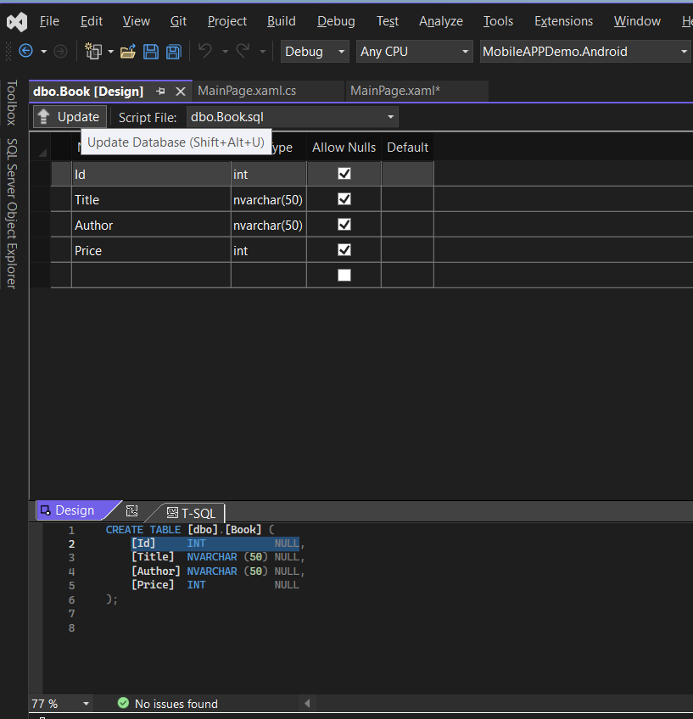

Slide 56
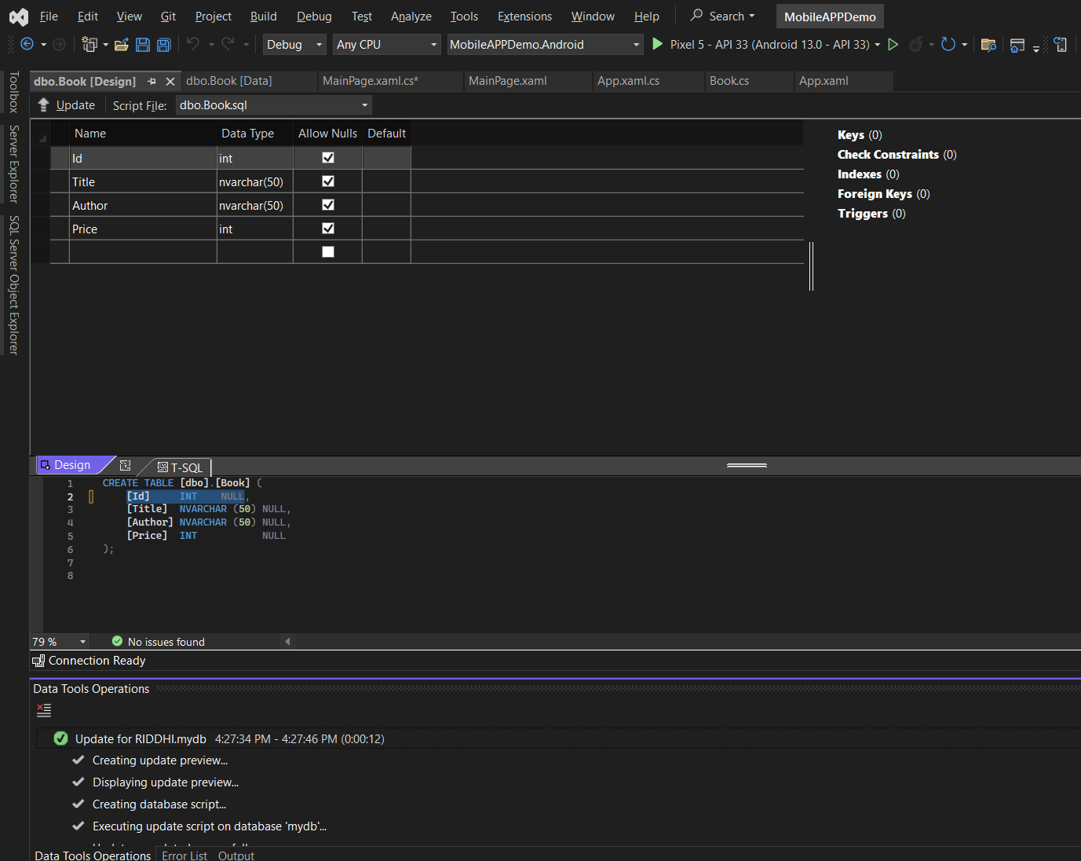

Slide 57
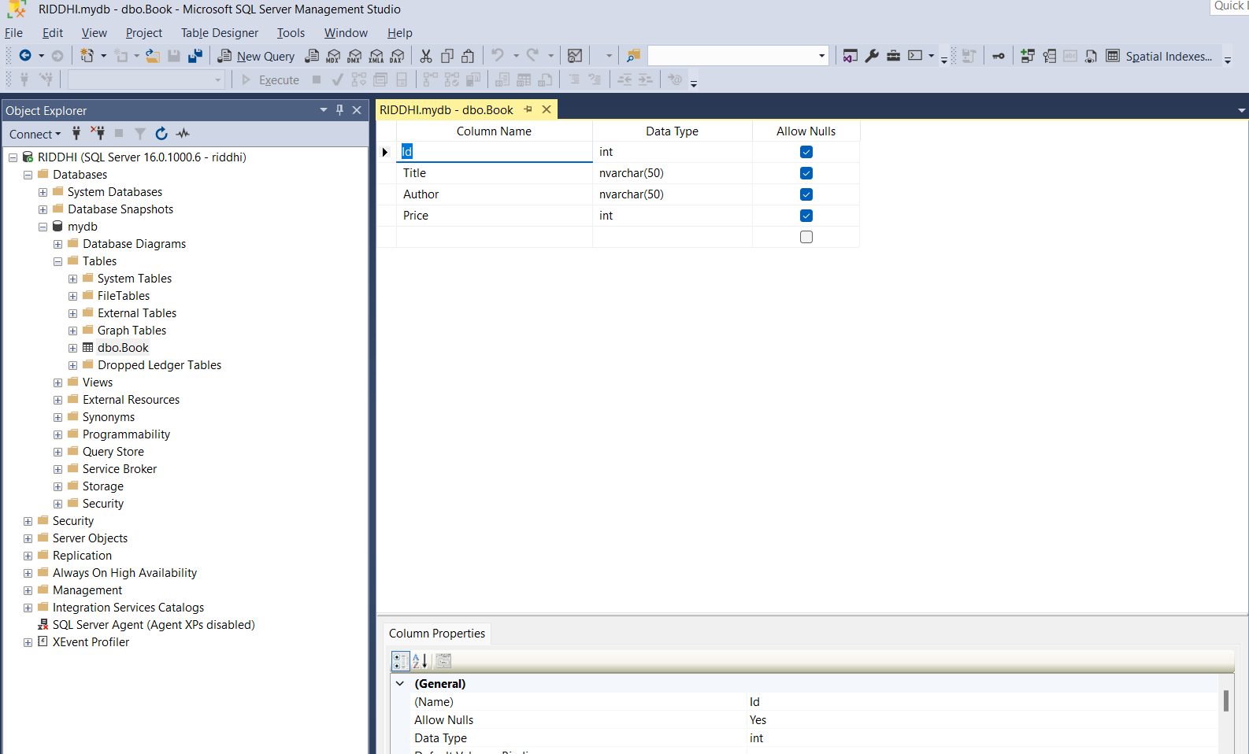

Slide 58
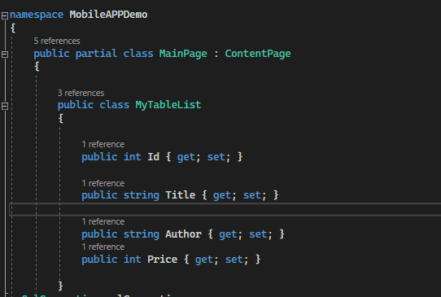

Slide 59
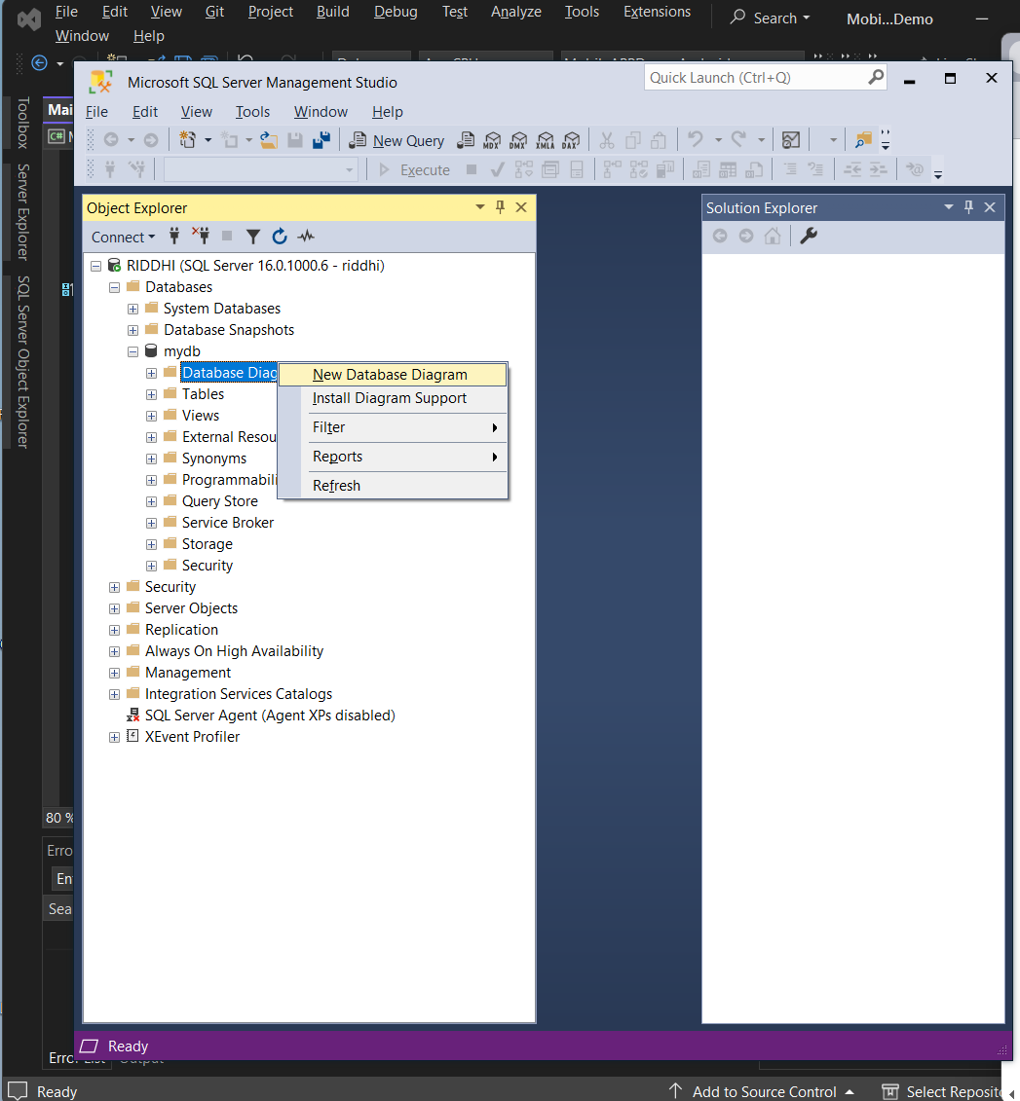

Slide 60


Slide 61


Slide 62


Slide 63


Slide 64


Slide 65
Xamarin –Mobile applications.
Mobile Application
1) Flyout – 2) Blank

Slide 66
Xamarin –Mobile applications.
Mobile Application
1) Flyout

Slide 67


Slide 68


Slide 69


Slide 70


Slide 71


Slide 72


Slide 73


Slide 74


Slide 75


Slide 76
The database setup is ready
The MVVM Application as programming side is connected to database

Slide 77
https://learn.microsoft.com/en-us/dotnet/architecture/maui/mvvm

Slide 78
Week | Topic
Week 6 | Objective 3: Implement the Model-View-View Model (MVVM) design pattern for data-connected applications. 3.1: Describe occasionally connected programming and database access. 3.2: Introduce MVVM application frameworks for attribute-based page and view model discovery.
SUMMERY

Slide 79

Any Questions

Slide 80
Week | Topic | Assessments and Activities | Learning Objectives
Week 6 | MVVM Design Pattern Implementation Building on MVVM, this week focuses on advanced topics in MVVM implementation. Data synchronization, database access, and occasionally connected programming. | Lecture and Discussions | Objective 3: Implement the Model-View-ViewModel (MVVM) design pattern for data connected applications. 3.3: Teach algorithms for manipulating databases using data objects. 3.4: Explain data synchronization between local and Cloud-based data stores.
NEXT

